Slide 1
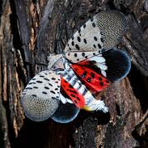
Tracking the Spread of the Invasive Spotted Lanternfly
Project Proposal Presentation
Team: George Lynch
Krishna Khanal
Sushrit Kafle
Venkatesh Bollineni

Slide 2
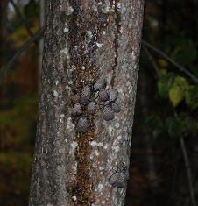
Spotted Lanternfly
Spotted lanternfly (Lycorma delicatula) or SLF, is an invasive insect pest from Asia that feed on a wide variety of plants such as grapevine, hops, maple, walnut, and fruit trees
It was first discovered in 2014 in the US ( Pennsylvania) and as of 2022, it has been found in 12 states.
They do not fly long distances, but it is a hitchhiker.
Starting in the fall, SLF seek out outdoor surfaces and lay mud-like egg masses on tree bark, outdoor gear (such as lawnmowers, bikes, and grills), methods of transport, and more.
Oozing wounds and adult SLF on a tree Photo: Pennsylvania Department of Agriculture, bugwood.org

Slide 3
Impacts:
Feeds on the sap of more than 70 plant species
Makes them vulnerable to diseases and insects.
Excretes large amounts of sticky "honeydew":
promotes the growth of sooty molds that interfere with plant photosynthesis,
results in people getting honeydew on their hair, clothes, and other belongings when going outside, hindering outdoor activities.
SLF invasion potentials are aligned globally because important viticultural regions with suitable environments for SLF establishment also heavily trade with invaded U.S. states.(Paninvasion severity assessment of a U.S. grape pest to disrupt the global wine market, 2021)
Using process-based modeling to forecast the spread of SLF assuming no treatments to control populations occur it was found that SLF has a low probability of first reaching the grape-producing counties of California, by 2027 and a high probability by 2033. (Spotted lanternfly predicted to establish in California by 2033 without preventative management,2022)

Slide 4
Dataset
lydemapr: an R package to track the spread of the invasive Spotted Lanternfly (Lycorma delicatula, White 1845) (Hemiptera, Fulgoridae) in the United States
Represents an anonymized and condensed comprehensive record of data
Collected by several federal agencies, state agencies, and citizen-science projects on the presence, establishment, and population density of spotted lanternfly in the United States

Slide 5
Dataset features
Lyde
(658390, 15)
2. survey,
3. year,
4. bio_year,
5. latitude,
6. longitude,
7. state,
8. lyde_present,
9. lyde_established,
10. lyde_density,
11. source_agency,
12. collection_method,
13. pointID,
14. rounded_longitude_10k,
15. rounded_latitude_10k
1. source,

Slide 6
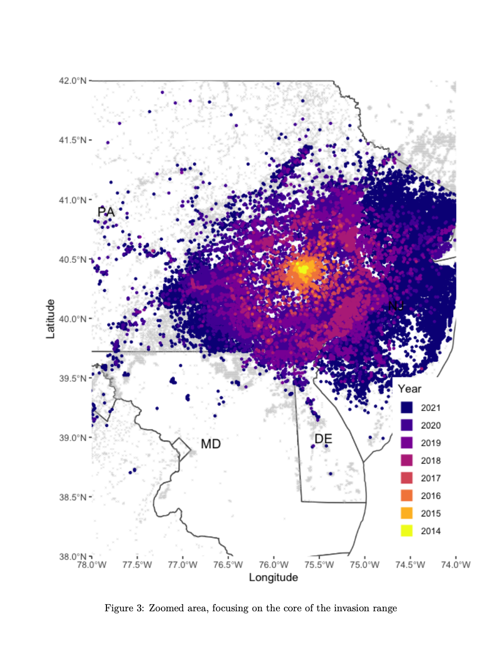
Machine Learning Techniques
Spatiotemporal data
Where and When?
Time-series analysis to understand the trends.
Classification algorithms to predict presence/absence of SLF.
Regression models to estimate population density and establishment of SLF.

Slide 7
Intended Expertiments
Understanding the trends in the spread of the spotted lanternfly
Will there be presence/absence of the species in specific locations.
Population Density forecasting
Add parameters to existing models
Model Evaluation:
Accuracy and Precision
MSE, RSS
Cross-validation techniques to reduce overfitting

Slide 8
REFERENCES
lydemapr: an R package to track the spread of the invasive Spotted Lanternfly (Lycorma delicatula, White 1845) (Hemiptera, Fulgoridae) in the United States, Sebastiano De Bona, Lawrence Barringer, Paul Kurtz, Jay Losiewicz, Gregory R. Parra, Matthew R. Helmus, bioRxiv 2023.01.27.525992; doi: https://doi.org/10.1101/2023.01.27.525992
Department of Environmental Conservation, Spotted Lanternfly, https://www.dec.ny.gov/animals/113303.html
Animal and Plant Health Inspection Service, U.S. Department of Agriculture; https://www.aphis.usda.gov/aphis/resources/pests-diseases/hungry-pests/the-threat/spotted-lanternfly/spotted-lanternfly
Paninvasion severity assessment of a U.S. grape pest to disrupt the global wine market, Nicholas A. Huron, Jocelyn E. Behm, Matthew R. Helmus, bioRxiv 2021.07.19.452723; doi: https://doi.org/10.1101/2021.07.19.452723
Jones, C., Skrip, M.M., Seliger, B.J. et al. Spotted lanternfly predicted to establish in California by 2033 without preventative management. Commun Biol 5, 558 (2022). https://doi.org/10.1038/s42003-022-03447-0

