Slide 1
Statistics Recap For Final Exam

Slide 2
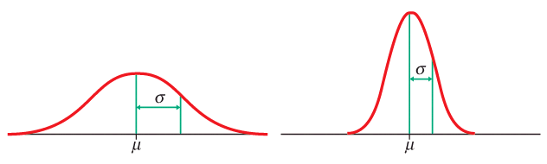
Normal distributions
Normal – or Gaussian – distributions are a family of symmetrical, bell-shaped density curves defined by a mean μ (mu) and a standard deviation σ (sigma) : N(μ,σ).
e = 2.71828… The base of the natural logarithm
π = pi = 3.14159…
Notes:
Commonly called the bell curve - if were skiing down it you are going steeper and steeper, then starts to flatten out.
This is the equation - don’t have to know it - basically for every value x, gestation time, you can plug it in and get f(x), the value on the y axis.
What we have done here is to go from a histogram, which is just your few data points, to this curve, which is a representation of what values you would get for any possible value of x whether you have it in your data set or not.

Slide 3
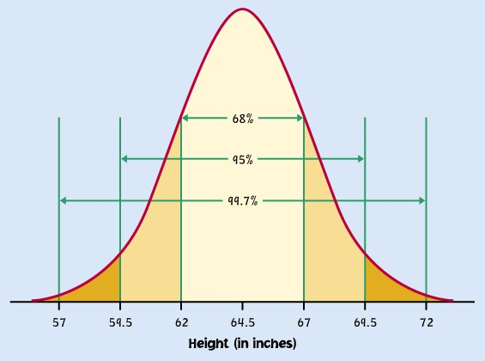
The 68-95-99.7% Rule for Normal Distributions
About 68% of all observations are within 1 standard deviation
(σ) of the mean (μ).
About 95% of all observations are within 2 σ of the mean μ.
Almost all (99.7%) observations are within 3 σ of the mean.
Inflection point
mean µ = 64.5 standard deviation σ = 2.5
N(µ, σ) = N(64.5, 2.5)
Reminder: µ (mu) is the mean of the idealized curve, while is the mean of a sample.
σ (sigma) is the standard deviation of the idealized curve, while s is the s.d. of a sample.
Notes:
Going to an example from the book on women’s heights, the mean here was 64.5, standard deviation 2.5 inches.
When we talk about the mean and standard deviation with respect to the curve instead of the actual sample, we use different notation.
Mu for mean, sigma for sd. If you consider the area under the curve to represent all of the individuals, then you can divide it into chunks to represent parts of the whole. Like if you divided it down the middle, half of the people are in each half. Here it is divided up into parts not through the middle but by lines that are 1, 2 or 3 standard deviations away from the mean. If you look at the center, pink part, it is the area 1 sd on either side of the mean. By definition for normal curves, this area is 68% of the total. So if you know the mean and sd, you also know that 68% of women are between 62 and 67 inches tall. Similarly for the areas defined by lines drawn 2 or 3 sd from the mean. We might want to know what percent of women are over 72 inches tall. That is 3 sd. We can see that 99.7 percent of women are less than 72 or greater than 57. Or that .3 percent of women are really tall or really short. Since the distribution is symmetric, we can divide by two to find the percent of women that are really tall: .15%
You need to be able to work problems like I just did - bunch in book. But what if you want to know something not defined by the sd? Like, what percentage of women are taller than 68 inches? Know that half are smaller than 64.5. And that half of this middle area, 34%, are smaller than 67 inches, so 50+34 = 84% are smaller than 67, or 16% are larger than 67 inches. But you want to know the proportion larger than 68 inches. You can look this up on a table, but first you have to do something called standardizing. The reason is that although all normal curves share the properties shown above, they differ by their mean and standard deviation. You would have to have a different table for every curve. When you standardize a normal distribution, you change it so the mean is 0 and the sd is 1. Any normal distribution can be standardized.

Slide 4
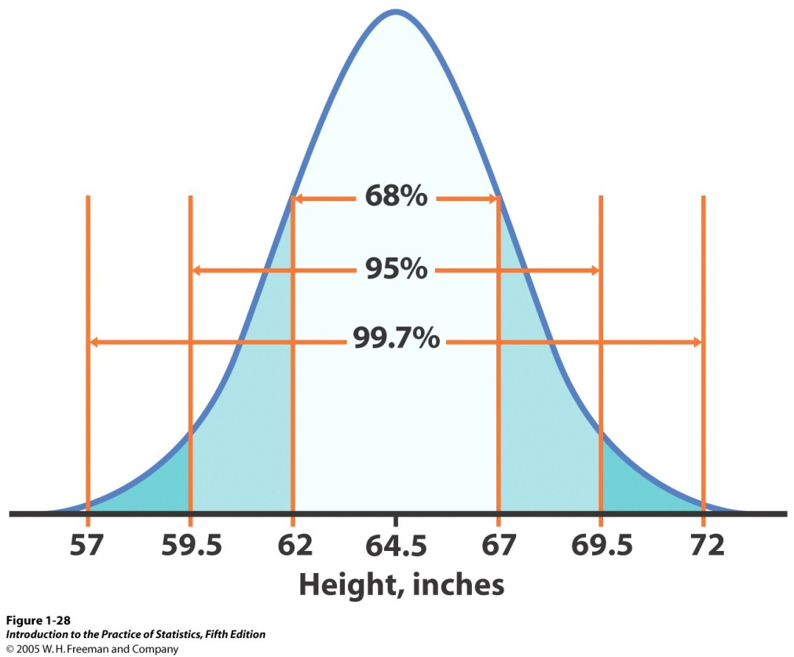
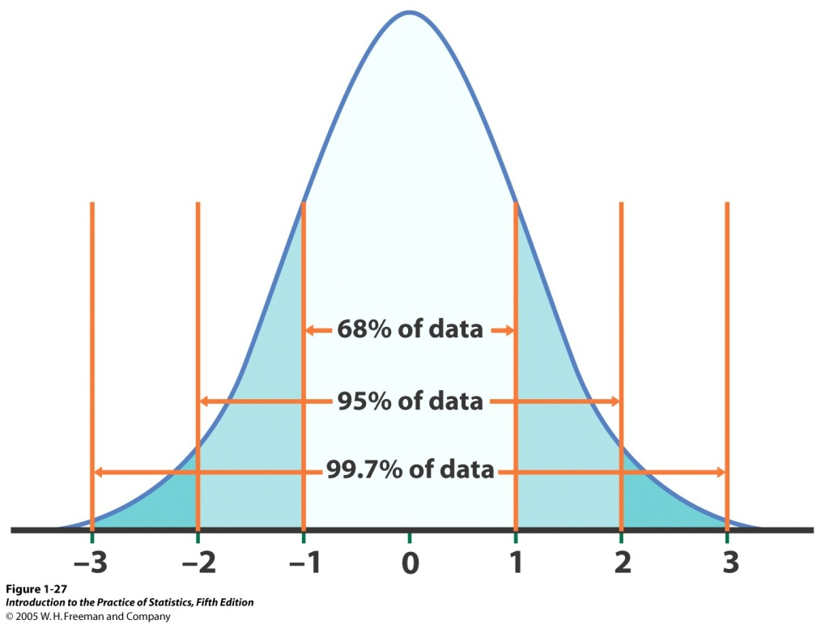
The standard Normal distribution
Because all Normal distributions share the same properties, we can standardize our data to transform any Normal curve N(μ,σ) into the standard Normal curve N(0,1).
N(64.5, 2.5)
N(0,1)
=>
Standardized height (no units)
For each x we calculate a new value, z (called a z-score).

Slide 5
Standardizing: calculating z-scores
A z-score measures the number of standard deviations that a data value x is from the mean μ.
When x is 1 standard deviation larger than the mean, then z = 1.
When x is 2 standard deviations larger than the mean, then z = 2.
When x is larger than the mean, z is positive.
When x is smaller than the mean, z is negative.
Notes:
We do this by standardizing the distributions - really all this is redefining them not changing the shape but the bottom axis so that instead of being N(mu, sigma) they are N(mean =0,sd=1), and the bottom axis is in terms of the SD rather than the Height.
You get this by calculating a value z for every point in x your data set. If you were to then draw the density curve for the z values you get a curve with a mean of 0 and a sd of 1. Once you have standardized, you can look up any value you want using a table. So, for instance, we knew that 68% of women were between 62 and 67 inches tall from knowing simple rules about 1,2,3 sd from mean. But if wanted to know the percentage of women that were less than 63 inches tall. Can’t just use those rules. need to standardize and go to table A - standard normal probabilities - on green card in book or in back. First standardize x to get z, the number of sd from the mean. It is 0.6 to the left (is negative). Look for -0.6 in left column (z), and then going across row, under .00 column (no more decimals on (-0.6) you find .2743. Twenty seven percent of women are shorter than 62 inches tall.

Slide 6
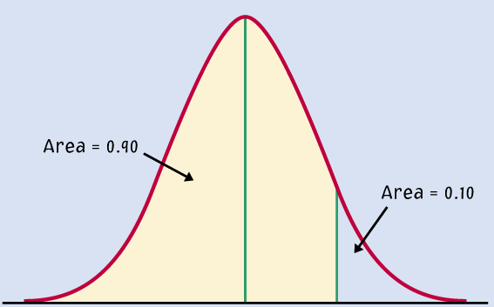
Ex. Women heights
N(µ, σ) = N(64.5, 2.5)
Women’s heights follow the N(64.5”,2.5”) distribution. What percent of women are shorter than 67 inches tall (that’s 5’6”)?
Area= ???
Area = ???
mean µ = 64.5"
standard deviation σ = 2.5"
x (height) = 67"
μ = 64.5” x = 67”
z = 0 z = 1
We calculate z, the standardized value of x:
Because of the 68-95-99.7 rule, we can conclude that the percent of women shorter than 67” should be, approximately, .68 + half of (1 - .68) = .84 or 84%.
Notes:
We do this by standardizing the distributions - really all this is redefining them not changing the shape but the bottom axis so that instead of being N(mu, sigma) they are N(0,1). we had a bunch of observations we called x - height of women, and they come from this distribution N(mu, sigma).
Percentage of women shorter than 67 is 50+half of 68=34, or 84%

Slide 7
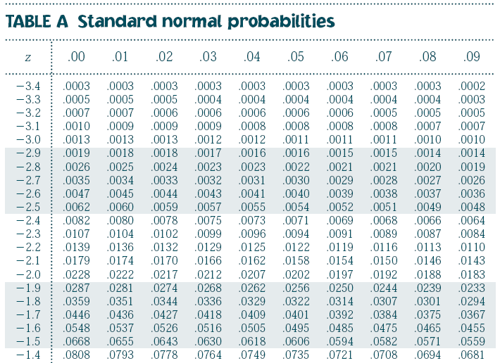
Using the standard Normal table
Table A gives the area under the standard Normal curve to the left of any z value.
.0082 is the area under N(0,1) left of z = -2.40
0.0069 is the area under N(0,1) left of z = -2.46
.0080 is the area under N(0,1) left of z = -2.41
(…)
Notes:
We do this by standardizing the distributions - really all this is redefining them not changing the shape but the bottom axis so that instead of being N(mu, sigma) they are N(mean =0,sd=1), and the bottom axis is in terms of the SD rather than the Height.
You get this by calculating a value z for every point in x your data set. If you were to then draw the density curve for the z values you get a curve with a mean of 0 and a sd of 1. Once you have standardized, you can look up any value you want using a table. So, for instance, we knew that 68% of women were between 62 and 67 inches tall from knowing simple rules about 1,2,3 sd from mean. But if wanted to know the percentage of women that were less than 63 inches tall. Can’t just use those rules. need to standardize and go to table A - standard normal probabilities - on green card in book or in back. First standardize x to get z, the number of sd from the mean. It is 0.6 to the left (is negative). Look for -0.6 in left column (z), and then going across row, under .00 column (no more decimals on (-0.6) you find .2743. Twenty seven percent of women are shorter than 62 inches tall.

Slide 8
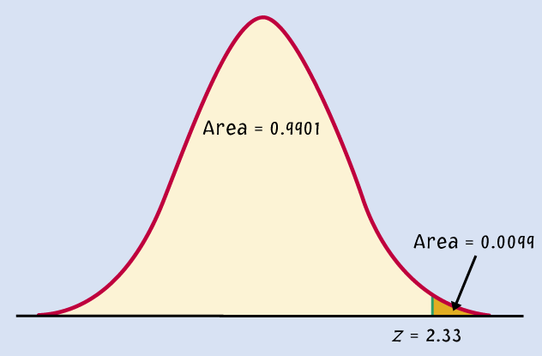
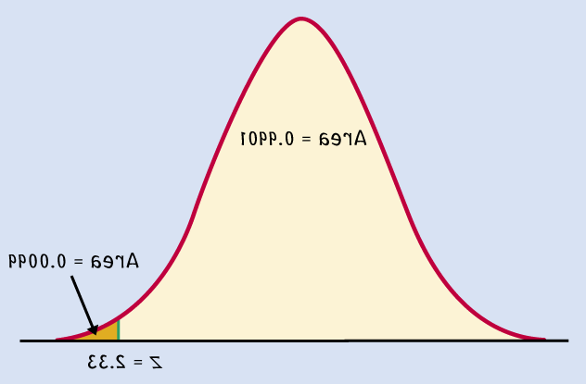
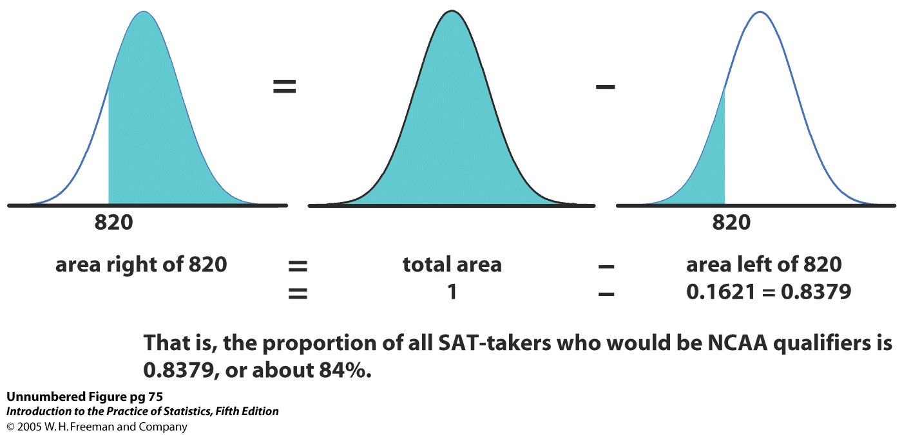
Tips on using Table A
Because the Normal distribution is symmetrical, there are 2 ways that you can calculate the area under the standard Normal curve to the right of a z value.
Area = 0.9901
Area = 0.0099
z = -2.33
area right of z = area left of -z
area right of z = 1 - area left of z

Slide 9
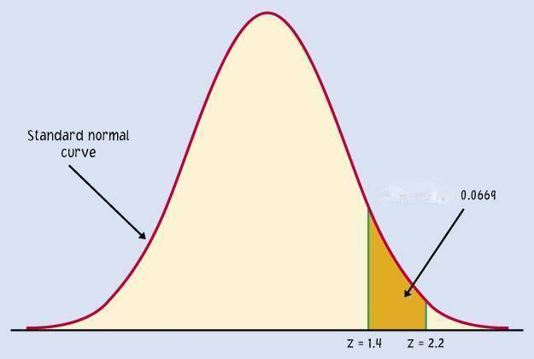
Tips on using Table A
To calculate the area between 2 z- values, first get the area under N(0,1) to the left for each z-value from Table A.
Then subtract the smaller area from the larger area.
A common mistake made by students is to subtract both z values. But the Normal curve is not uniform.
area between z₁ and z₂ =
area left of z₁ – area left of z₂
➔ The area under N(0,1) for a single value of z is zero.
(Try calculating the area to the left of z minus that same area!)

Slide 10
EX 1: The National Collegiate Athletic Association (NCAA) requires Division I athletes to score at least 820 on the combined math and verbal SAT exam to compete in their first college year. The SAT scores of 2003 were approximately normal with mean 1026 and standard deviation 209.
What proportion of all students would be NCAA qualifiers (SAT ≥ 820)?
area right of 820 = total area - area left of 820
= 1 - 0.1611
≈ 84%
Note: The actual data may contain students who scored exactly 820 on the SAT. However, the proportion of scores exactly equal to 820 is 0 for a normal distribution as a consequence of the idealized smoothing of density curves.

Slide 11
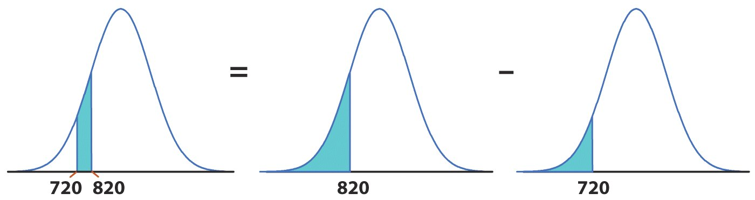
The NCAA defines a “partial qualifier” eligible to practice and receive an athletic scholarship, but not to compete, with a combined SAT score of at least 720.
What proportion of all students who take the SAT would be partial qualifiers? That is, what proportion have scores between 720 and 820?
area between = area left of 820 - area left of 720
720 and 820 = 0.1611 - 0.0721
≈ 9%
About 9% of all students who take the SAT have scores between 720 and 820.

Slide 12
EX 2: Gestation time in malnourished mothers
What is the effect of better maternal care on gestation time and preemies?
The goal is to obtain pregnancies 240 days (8 months) or longer.
What improvement did we get by adding better food?
= 266
σ = 15
= 250
σ = 20
Notes:
Now, this will become more apparent later on in the class, but the cool thing about standardizing is that it allows you to compare across different scales.
Remember we started out the day using gestation time as an example. Women who are malnourished risk have premature babies, and studies are being done to see whether different diet and vitamin supplements work better. Let’s say the goal is to get them to carry the baby at least 240 days (8 months). For treatment 1, say vitamins only, get normal distribution with mean 250, sd is 20.
Treatment 2 is vitamins plus a meals on wheels program. Mean is 266, sd 15 . The mean is increased, but the spread has changed too. You can eyeball this and see that more of the women in treatment two are above our goal of 240 days, but how much of an improvement is it?

Slide 13
Under each treatment, what percent of mothers failed to carry their babies at least 240 days?
Vitamins Only
μ=250, σ=20,
x=240
Vitamins only: 30.85% of women would be expected to have gestation times shorter than 240 days.
Notes:
Remember we started out the day using gestation time as an example. Women who are malnourished risk have premature babies, and studies are being done to see whether different diet and vitamin supplements work better. Let’s say the goal is to get them to carry the baby at least 240 days (8 months). For treatment 1, say vitamins only, get normal distribution with mean 250, sd is 20.
Treatment 2 is vitamins plus a meals on wheels program. Mean is 266, sd 15 . You can eyeball this and see that more of the women in treatment two are above our goal of 240 days, but how much of an improvement is it? The mean is increased, but the spread has changed too. Let’s standardize to get the proportion of women below 240 in each distribution.
Go through - bottom line is that adding food to vitamins resulted in the proportion of women with gestation times of less than 240 days going from 30.85% to only 4.18%. You see figures like this in news stories all the time - if you went to the primary (medical literature) you would see that they had to go through this rigamarole to get you that tidy summary.

Slide 14
Vitamins and better food
μ=266, σ=15,
x=240
Vitamins and better food: 4.18% of women would be expected to have gestation times shorter than 240 days.
Compared to vitamin supplements alone, vitamins and better food resulted in a much smaller percentage of women with pregnancy terms below 8 months (4% vs. 31%).
Notes:
Remember we started out the day using gestation time as an example. Women who are malnourished risk have premature babies, and studies are being done to see whether different diet and vitamin supplements work better. Let’s say the goal is to get them to carry the baby at least 240 days (8 months). For treatment 1, say vitamins only, get normal distribution with mean 250, sd is 20.
Treatment 2 is vitamins plus a meals on wheels program. Mean is 266, sd 15 . You can eyeball this and see that more of the women in treatment two are above our goal of 240 days, but how much of an improvement is it? The mean is increased, but the spread has changed too. Let’s standardize to get the proportion of women below 240 in each distribution.
Go through - bottom line is that adding food to vitamins resulted in the proportion of women with gestation times of less than 240 days going from 30.85% to only 4.18%. You see figures like this in news stories all the time - if you went to the primary (medical literature) you would see that they had to go through this rigamarole to get you that tidy summary.

Slide 15
EX 3: Inverse normal calculations
We may also want to find the observed range of values that correspond to a given proportion/ area under the curve.
For that, we use Table A backward:
we first find the desired area/ proportion in the body of the table,
we then read the corresponding z-value from the left column and top row.
For an area to the left of 1.25 % (0.0125),
the z-value is -2.24
Notes:
Commonly called the bell curve - if were skiing down it you are going steeper and steeper, then starts to flatten out.
This is the equation - don’t have to know it - basically for every value x, gestation time, you can plug it in and get f(x), the value on the y axis.
What we have done here is to go from a histogram, which is just your few data points, to this curve, which is a representation of what values you would get for any possible value of x whether you have it in your data set or not.

Slide 16
Vitamins and better food
How long are the longest 75% of pregnancies when mothers with malnutrition are given vitamins and better food?
μ=266, σ=15,
upper area 75%
upper 75%
?
Remember that Table A gives the area to the left of z. Thus, we need to search for the lower 25% in Table A in order to get z.
➔ The 75% longest pregnancies in this group are about 256 days or longer.
Notes:
Remember we started out the day using gestation time as an example. Women who are malnourished risk have premature babies, and studies are being done to see whether different diet and vitamin supplements work better. Let’s say the goal is to get them to carry the baby at least 240 days (8 months). For treatment 1, say vitamins only, get normal distribution with mean 250, sd is 20.
Treatment 2 is vitamins plus a meals on wheels program. Mean is 266, sd 15 . You can eyeball this and see that more of the women in treatment two are above our goal of 240 days, but how much of an improvement is it? The mean is increased, but the spread has changed too. Let’s standardize to get the proportion of women below 240 in each distribution.
Go through - bottom line is that adding food to vitamins resulted in the proportion of women with gestation times of less than 240 days going from 30.85% to only 4.18%. You see figures like this in news stories all the time - if you went to the primary (medical literature) you would see that they had to go through this rigamarole to get you that tidy summary.

Slide 17
Objectives
Estimating with confidence
  Statistical confidence
  Confidence intervals
  Confidence interval for a population mean
  How confidence intervals behave
  Choosing the sample size

Slide 18
Overview of Inference
Methods for drawing conclusions about a population from sample data are called statistical inference
Methods
    Confidence Intervals - estimate a population parameter
    Tests of significance - assess evidence for a claim about a population
Inference is appropriate when data are produced by either
      a random sample or
      a randomized experiment

Slide 19
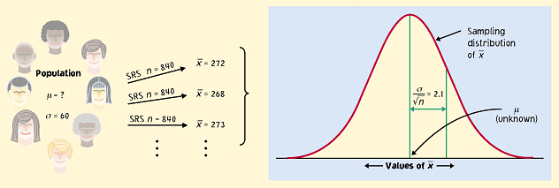
Statistical confidence
Although the sample mean, , is a unique number for any particular sample, if you pick a different sample you will probably get a different sample mean.
In fact, you could get many different values for the sample mean, and virtually none of them would actually equal the true population mean, μ.
x

Slide 20
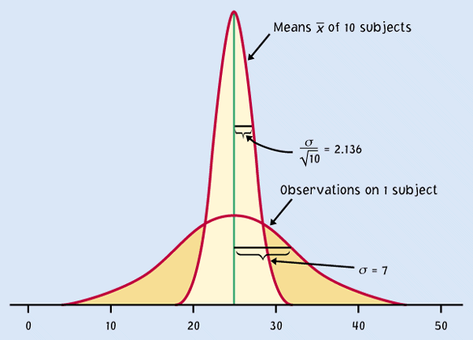
But the sample distribution is narrower than the population distribution, by a factor of √n.
Thus, the estimates
gained from our samples
are always relatively
close to the population
parameter µ.
n
Sample means,
n subjects
Population, x
individual subjects
μ
If the population is normally distributed N(µ,σ),
so will the sampling distribution N(µ,σ/√n),

Slide 21
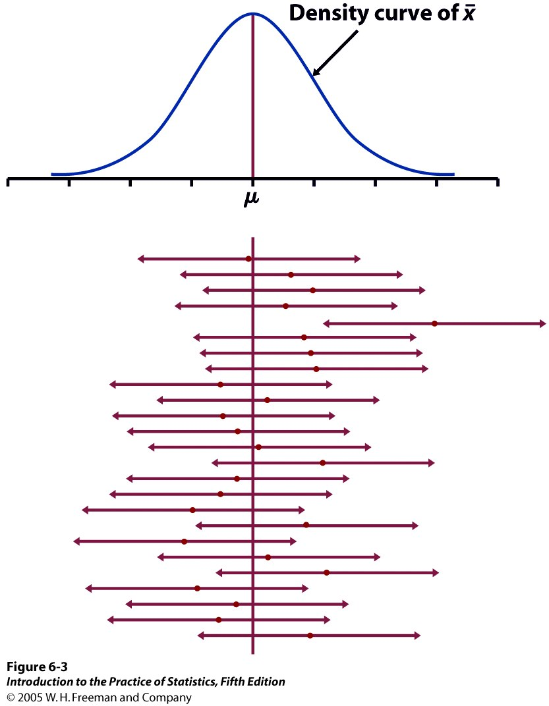
95% of all sample means will be within roughly 2 standard deviations (2*σ/√n) of the population parameter μ.
Distances are symmetrical which implies that the population parameter μ must be within roughly 2 standard deviations from the sample average , in 95% of all samples.
Red dot: mean value
of individual sample
This reasoning is the essence of statistical inference.

Slide 22



The weight of single eggs of the brown variety is normally distributed N(65 g,5 g).
Think of a carton of 12 brown eggs as an SRS of size 12.
.
What is the distribution of the sample means ?
Find the middle 95% of the sample means distribution.
You buy a carton of 12 white eggs instead. The box weighs 770 g. The average egg weight from that SRS is thus 64.2 g.
Knowing that the standard deviation of egg weight is 5 g regardless of color, what can you infer about the mean µ of the white egg population?

Slide 23
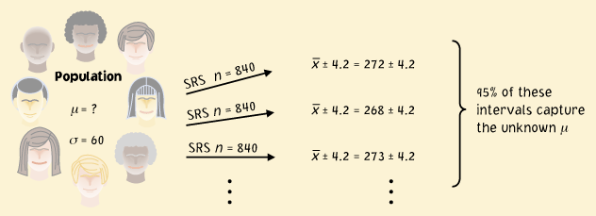
Confidence intervals
The confidence interval is a range of values with an associated probability or confidence level C. The probability quantifies the chance that the interval contains the true population parameter.
W
Where did we get 4.2?
± 4.2 is a 95% confidence interval for the population parameter μ.
This equation says that in 95% of the cases, the actual value of μ will be within 4.2 units of the value of .

Slide 24
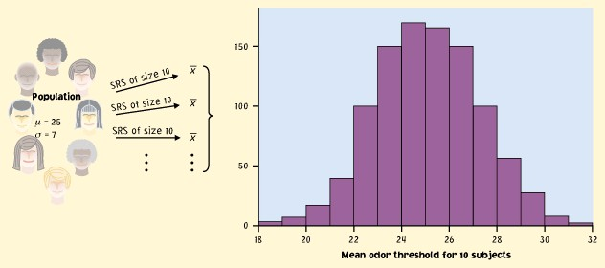
Implications
We don’t need to take a lot of random samples to “rebuild” the sampling distribution and find μ at its center.
n
All we need is one SRS of size n and rely on the properties of the sample means distribution to infer the population mean μ.
Sample
Population
n
μ

Slide 25
Reworded
With 95% confidence, we can say that µ should be within roughly 2 standard deviations (2*σ/√n) from our sample mean .
  In 95% of all possible samples of this size n, µ will indeed fall in our confidence interval.
  In only 5% of samples would be farther from µ.

Slide 26
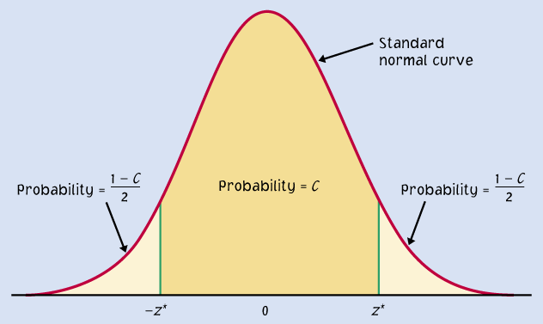
A confidence interval can be expressed as:
Sample mean ± m
m is called the margin of error
μ is within ± m
Example: 120 ± 6
Two endpoints of an interval
μ within ( − m) to ( + m)
ex. 114 to 126
A confidence level C (in %) indicates the probability that µ falls within the interval.
It represents the area under the normal curve within ± m of the center of the curve.
So what is m?
m
m

Slide 27
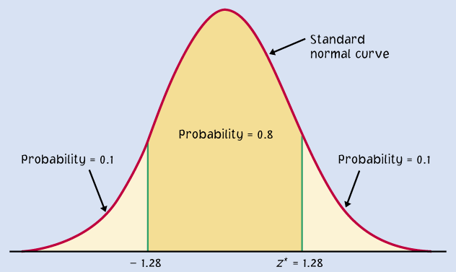
Finding the margin of error m
Confidence intervals contain the population mean μ in C% of samples. Different areas under the curve give different confidence levels C.
z* is z-value associated with the chosen confidence level C. It is always positive.
C is the area under the standard normal curve between −z* and z*.
C
The confidence interval is thus:
−z*
z*
Example: For an 80% confidence level C, 80% of the normal curve’s
area is contained in the interval.
Notice that m depends on 3 known terms

Slide 28

Using Table D to find specific z* values?
We can use the normal table of z values (Table D). For a particular confidence level, C, the appropriate z* value is just above it.
Example: For a 98% confidence level, z*=2.326
We can use software. In R: z* = abs(qnorm(desired probability))): For C = 80%
Since we want the middle C probability, the probability we require is (1 - C)/2
Another Example: For 98% C, z* = abs(qnorm(0.01)) = 2.32635
> qnorm(0.1)
[1] -1.281552
> qnorm(.9)
[1] 1.281552
> abs(qnorm(.1))
[1] 1.281552

Slide 29
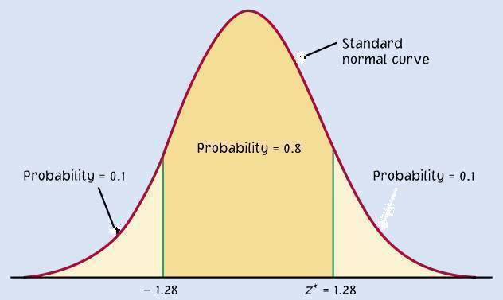
Link between confidence level and margin of error
The confidence level C determines the value of z*.
The margin of error, in turn, depends on z*.
Higher confidence C implies a larger margin of error m (thus less precision in our estimates).
A lower confidence level C produces a smaller margin of error m (thus better precision in our estimates).
C
m m
−z*
z*

Slide 30
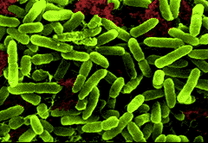
Different confidence intervals for the same set of measurements
Density of bacteria in solution:
Measurement equipment has standard deviation
σ = 1 * 10⁶ bacteria/ml fluid.
Three measurements: (24, 29, 31) in 10⁶ bacteria/ml fluid
Mean: = 28 * 10⁶ bacteria/ml. Find the 96% and 70% CI.

Slide 31
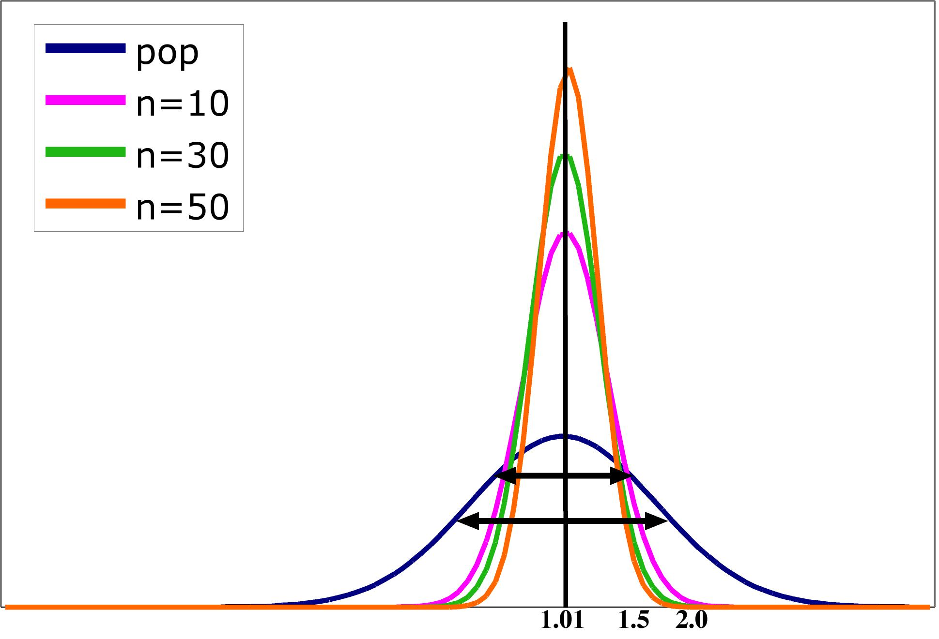

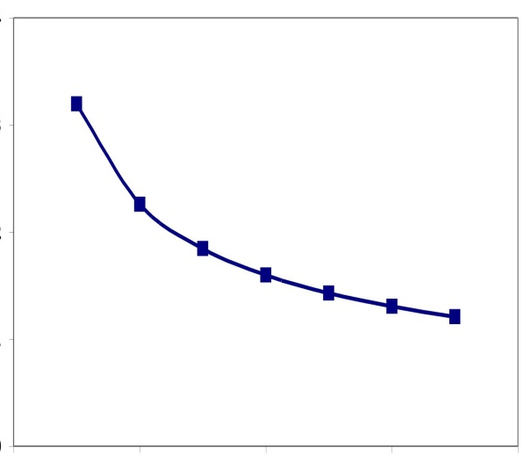
Impact of sample size
The spread in the sampling distribution of the mean is a function of the number of individuals per sample.
  The larger the sample size, the smaller
  the standard deviation (spread) of the
  sample mean distribution.
  But the spread only decreases at a rate
  equal to √n.
Standard error σ ⁄ √n
Sample size n

Slide 32
Sample size and experimental design
You may need a certain margin of error (e.g., drug trial, manufacturing specs). In many cases, the population variability (σ) is fixed, but we can choose the number of measurements (n).
So plan ahead what sample size to use to achieve that margin of error.
Remember, though, that sample size is not always stretchable at will. There are typically costs and constraints associated with large samples. The best approach is to use the smallest sample size that can give you useful results.

Slide 33
What sample size for a given margin of error?
Density of bacteria in solution:
Measurement equipment has standard deviation
σ = 1 * 10⁶ bacteria/ml fluid.
How many measurements should you make to obtain a margin of error of at most 0.5 * 10⁶ bacteria/ml with a confidence level of 90%?
For a 90% confidence interval, z* = 1.645.

Slide 34
Introduction to Inference
Tests of Significance

Slide 35
Objectives
Tests of significance
  The reasoning of significance tests
  Stating hypotheses
  The P-value
  Statistical significance
  Tests for a population mean
  Confidence intervals to test hypotheses

Slide 36

Reasoning of Significance Tests
We have seen that the properties of the sampling distribution of help us estimate a range of likely values for population mean μ.
We can also rely on the properties of the sample distribution to test hypotheses.
Example: You are in charge of quality control in your food company. You sample randomly four packs of cherry tomatoes, each labeled 1/2 lb. (227 g).
The average weight from your four boxes is 222 g. Obviously, we cannot expect boxes filled with whole tomatoes to all weigh exactly half a pound. Thus,
  Is the somewhat smaller weight simply due to chance variation?
  Is it evidence that the calibrating machine that sorts
  cherry tomatoes into packs needs revision?

Slide 37

Stating hypotheses
A test of statistical significance tests a specific hypothesis using sample data to decide on the validity of the hypothesis.
In statistics, a hypothesis is an assumption or a theory about the characteristics of one or more variables in one or more populations.
  What you want to know: Does the calibrating machine that sorts cherry tomatoes into packs need revision?
  The same question reframed statistically: Is the population mean µ for the distribution of weights of cherry tomato packages equal to 227 g (i.e., half a pound)?

Slide 38
The null hypothesis is a very specific statement about a parameter of the population(s). It is labeled H₀.
The alternative hypothesis is a more general statement about a parameter of the population(s) that is exclusive of the null hypothesis. It is labeled H_{a}.
In our cherry tomato example, what are the null and alternative?

Slide 39
One-sided and two-sided tests
A two-tail or two-sided test of the population mean has these null and alternative hypotheses:
  H₀ : µ = [a specific number] H_{a} : µ ≠ [a specific number]
A one-tail or one-sided test of a population mean has these null and alternative hypotheses:
  H₀ : µ = [a specific number] H_{a} : µ < [a specific number] OR
  H₀ : µ = [a specific number] H_{a} : µ > [a specific number]
  The FDA tests whether a generic drug has an absorption extent similar to the known absorption extent of the brand-name drug it is copying. Higher or lower absorption would both be problematic, thus we test:

Slide 40
How to choose?
What determines the choice of a one-sided versus a two-sided test is what we know about the problem before we perform a test of statistical significance.
  A health advocacy group tests whether the mean nicotine content of a brand of cigarettes is greater than the advertised value of 1.4 mg.
  Here, the health advocacy group suspects that cigarette manufacturers sell cigarettes with a nicotine content higher than what they advertise in order to better addict consumers to their products and maintain revenues.
  Thus, this is a one-sided test: H₀ : µ = 1.4 mg H_{a} : µ > 1.4 mg
It is important to make that choice before performing the test or else you could make a choice of “convenience” or fall into circular logic.

Slide 41
The P-value
The packaging process has a known standard deviation σ = 5 g.
H₀ : µ = 227 g versus H_{a} : µ ≠ 227 g
The average weight from your four random boxes is 222 g.
What is the probability of drawing a random sample such this if H₀ is true?
Tests of statistical significance quantify the chance of obtaining a particular random sample result if the null hypothesis were true. This quantity is the P-value.
This is a way of assessing the “believability” of the null hypothesis, given the evidence provided by a random sample.

Slide 42
Interpreting a P-value
Could random variation alone account for the difference between the null hypothesis and observations from a random sample?
  A small P-value implies that random variation due to the sampling process alone is not likely to account for the observed difference.
  With a small p-value we reject H₀. The true property of the population is significantly different from what was stated in H₀.
Thus, small P-values are strong evidence AGAINST H₀.
But how small is small…?

Slide 43
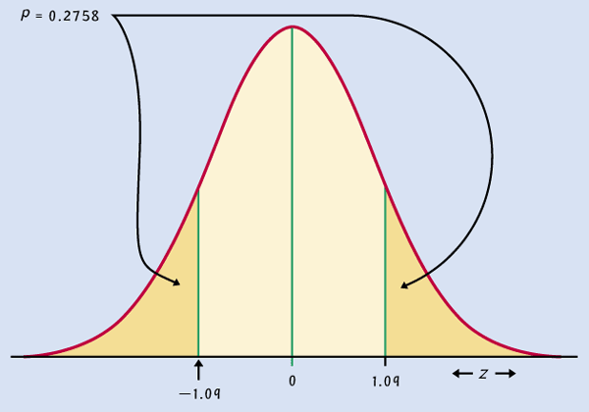
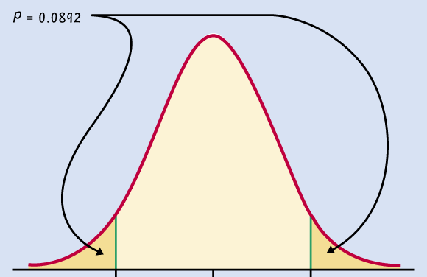
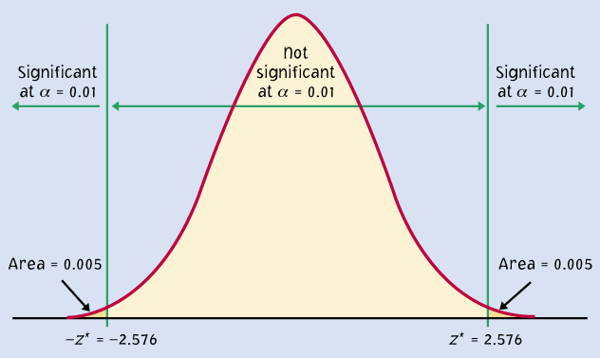
Significant P-value ???
P = 0.28
When the shaded area becomes very small, the probability of drawing such a sample at random gets very slim. Oftentimes, a P-value of 0.05 or less is considered significant: The phenomenon observed is unlikely to be entirely due to chance event from the random sampling.
CAUTION: The p-value depends on the form of the test. For a two-sided test we consider the possibility of having an observation in either tale.
CAUTION: We should decide on the significance level before we do the test.
P = 0.09
P = 0.01

Slide 44
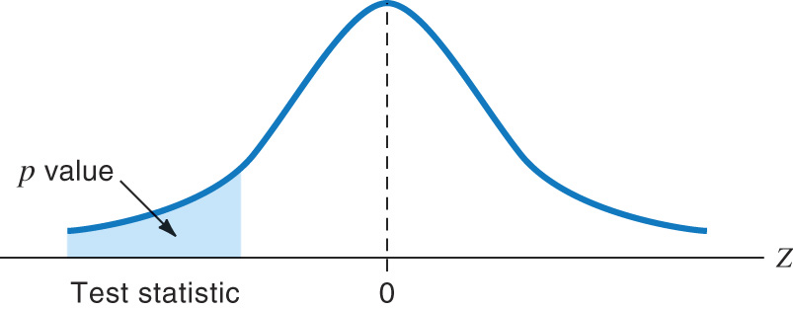
Tests for a population mean
To test the hypothesis H₀ : µ = µ₀ based on an SRS of size n from a Normal population with unknown mean µ and known standard deviation σ, we rely on the properties of the sampling distribution N(µ, σ/√n).
The P-value is the area under the sampling distribution for values at least as extreme, in the direction of H_{a}, as that of our random sample.
Again, we first calculate a z-value
and then use Table A.
Sampling distribution
σ/√n
µ
defined by H₀

Slide 45
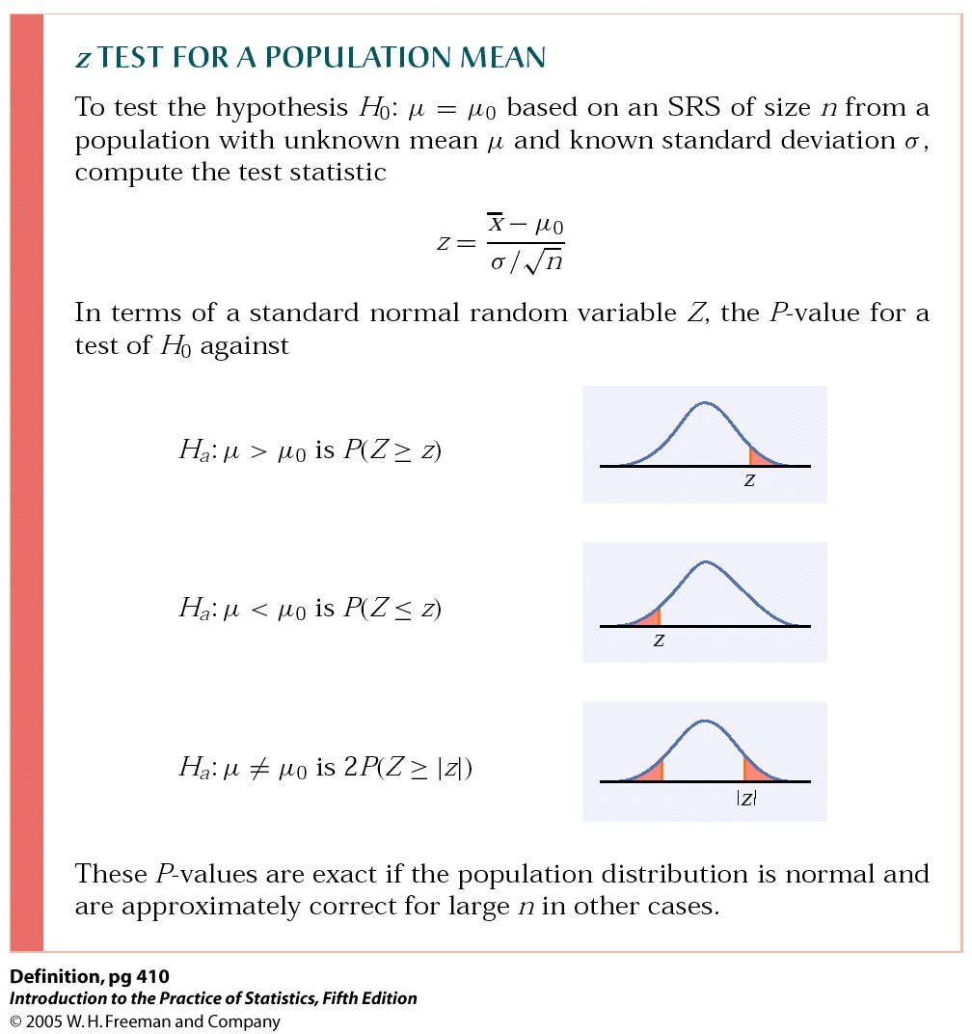
P-value in one-sided and two-sided tests
One-sided (one-tailed) test
Two-sided (two-tailed) test
To calculate the P-value for a two-sided test, use the symmetry of the normal curve. Find the P-value for a one-sided test and double it.

Slide 46
Does the packaging machine need revision?
  H₀ : µ = 227 g versus H_{a} : µ ≠ 227 g
  What is the probability of drawing a random sample such as yours if H₀ is true?
Sampling distribution
σ/√n = 2.5 g
µ (H₀)

Slide 47
The significance level α
The significance level, α, is the largest P-value tolerated for rejecting a true null hypothesis (how much evidence against H₀ we require). This value is decided arbitrarily before conducting the test.
  If the P-value is equal to or less than α (P ≤ α), then we reject H₀.
  If the P-value is greater than α (P > α), then we fail to reject H₀.
Does the packaging machine need revision?
Two-sided test. The P-value is 4.56%.
* If α had been set to 5%, then the P-value would be significant.
* If α had been set to 1%, then the P-value would not be significant.

Slide 48
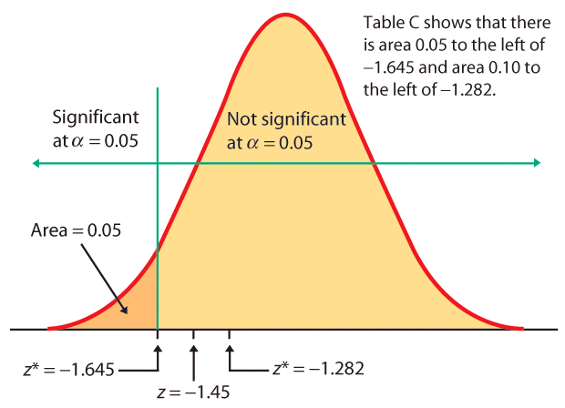
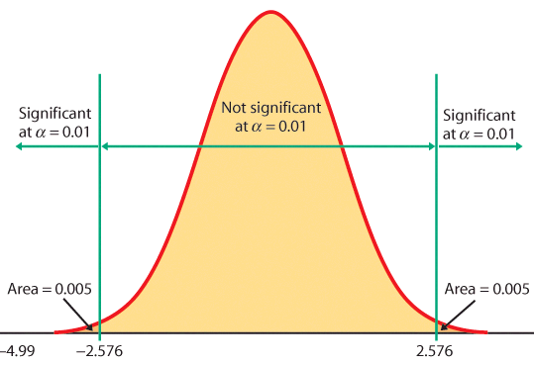
When the z score falls within the rejection region (shaded area on the tail-side), the p-value is smaller than α and you have shown statistical significance.
z = -1.645
One-sided test, α = 5%
Two-sided test, α = 1%
Z

Slide 49
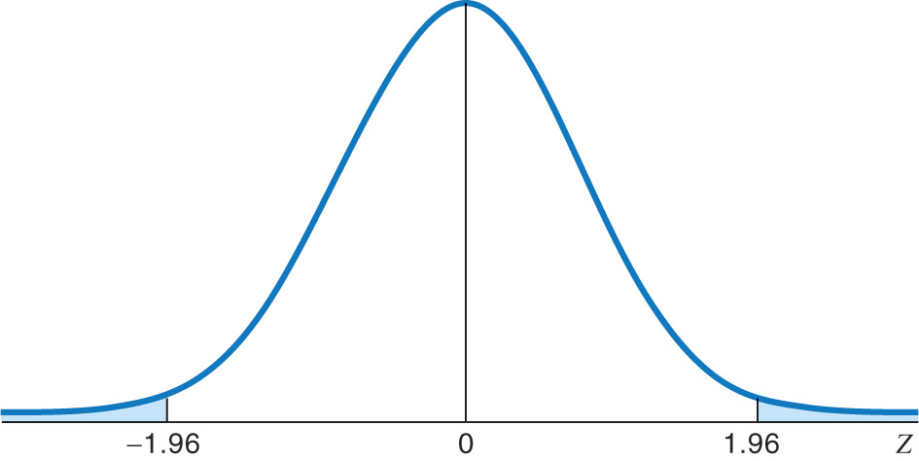

Rejection region for a two-tail test of µ with α = 0.05 (5%) is related to confidence interval.
A two-sided test means that α is spread between both tails of the curve, thus:
-A middle area C of 1 − α = 95%, and
-An upper tail area of α /2 = 0.025.
0.025
0.025
Table C

Slide 50
Confidence intervals to test hypotheses
Because a two-sided test is symmetrical, you can also use a CI to test a two-sided hypothesis.
In a two-sided test,
C = 1 – α.
C confidence level
α significance level
For cherry tomato eg:
σ = 5 g ,
H₀ : µ = 227 g vs
H_{a} : µ ≠ 227 g.
What is CI?
Would we reject null?
α /2
α /2

Slide 51
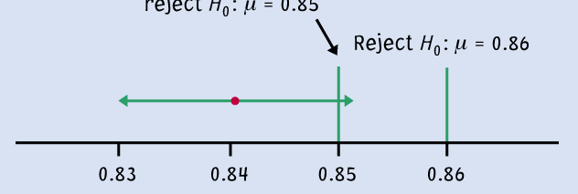
Logic of confidence interval test
Ex: Your sample gives a 99% confidence interval of .
With 99% confidence, could samples be from populations with µ = 0.86? µ = 0.85?
Cannot reject
H₀: μ = 0.85
Reject H₀ : μ = 0.86
99% C.I.
A confidence interval gives a black and white answer: Reject or don't reject H₀. But it also estimates a range of likely values for the true population mean µ.
A P-value quantifies how strong the evidence is against the H₀. But if you reject H₀, it doesn’t provide any information about the true population mean µ.

Slide 52
Inference for Distributions
- for the Mean of a Population

Slide 53
Objectives (IPS Chapter 7.1)
Inference for the mean of a population
  The t distributions
  The one-sample t confidence interval
  The one-sample t test
  Matched pairs t procedures
  Robustness
  Power of the t-test

Slide 54
Level of phosphate in the blood
The level of phosphate in the blood of kidney dialysis patients is of concern because of nutritional issues involved with dialysis. Blood tests for a particular patient were performed on six consecutive clinic visits. The level of phosphate, in milligrams per deciliter of blood, was recorded. An individual’s phosphate levels vary Normally over time with an unknown standard deviation.
Visit mg/dl
1 5.6
2 5.1
3 4.6
4 4.8
5 5.7
6 6.4
We want to estimate the patient’s mean phosphate level with a confidence interval, or we could want to test if the true mean is a particular value:
H₀: μ = 4.9 versus H_{a}: μ > 0
This looks familiar. However, here we do not know the population parameter σ , perhaps because it is different for different patients.
This situation of an unknown variance is very common with real data.

Slide 55
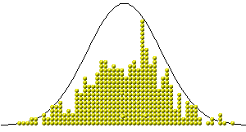
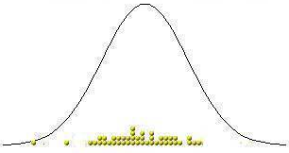
When σ is unknown
The sample standard deviation s provides an estimate of the population standard deviation σ.
When the sample size is large, the sample is likely to contain elements representative of the whole population. Then s is a good estimate of σ.
But when the sample size is small, the sample contains only a few individuals. Then s is a mediocre estimate of σ.
Population
distribution
Large sample
Small sample

Slide 56
Sample Standard deviation is s and our sampling distribution standard error is now s/√n
Recall that for a sample of size n,
the sample standard deviation s is:
where n − 1 is the “degrees of freedom.”
The value s/√n is called the standard error of the mean .
In our example, we will use s to estimate σ:

Slide 57
The t distributions
Suppose that an SRS of size n is drawn from an N(µ, σ) population.
When σ is known, the sampling distribution is N(μ, σ/√n).
When σ is estimated by the sample standard deviation s, the sampling distribution of t follows a t distribution with degrees of freedom n − 1, where
is the one-sample t statistic

Slide 58
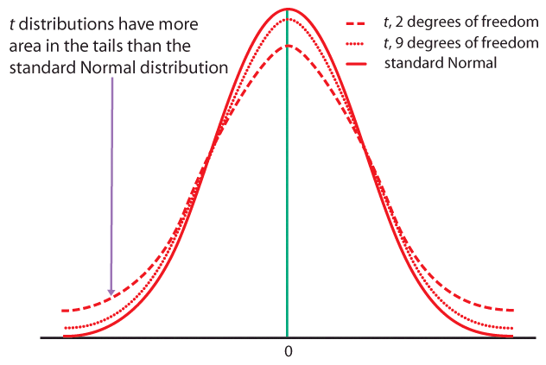
When n is very large, s is a very good estimate of σ, and the corresponding t distributions are very close to the normal distribution.
The t distributions become wider for smaller sample sizes, reflecting the lack of precision in estimating σ from s.

Slide 59
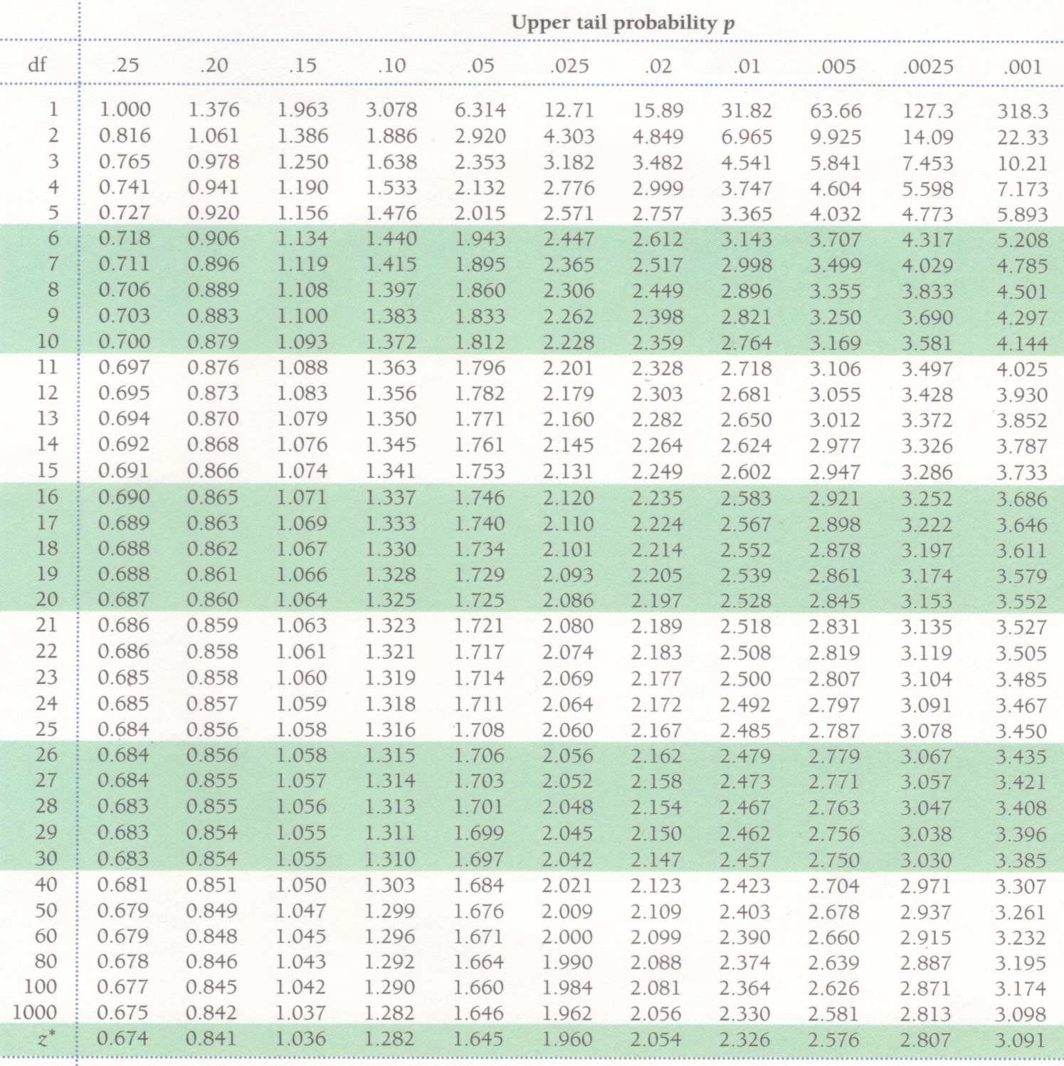
Table D
When σ is unknown, we use a t distribution with “n−1” degrees of freedom (df).
Table D shows the
z-values and t-values corresponding to landmark P-values/ confidence levels.
When σ is known, we use the normal distribution and the standardized z-value.

Slide 60
The one-sample t-confidence interval
The level C confidence interval is an interval with probability C of containing the true population parameter.
We have a data set from a population with both μ and σ unknown. We use to estimate μ and s to estimate σ, using a t distribution df (n−1).
Practical use of t : t*
C is the area between −t* and t*.
We find t* in the line of Table D for df = n−1 and confidence level C.
The margin of error m is:
C
m m
−t*
t*

Slide 61


Red wine, in moderation
Drinking red wine in moderation may protect against heart attacks. The polyphenols it contains act on blood cholesterol, likely helping to prevent heart attacks.
To see if moderate red wine consumption increases the average blood level of polyphenols, a group of nine randomly selected healthy men were assigned to drink half a bottle of red wine daily for two weeks. Their blood polyphenol levels were assessed before and after the study, and the percent change is presented here:
Firstly: Are the data approximately normal?
0.7 | 3.5 | 4 | 4.9 | 5.5 | 7 | 7.4 | 8.1 | 8.4
There is a low value, but overall the data can be considered reasonably normal.

Slide 62
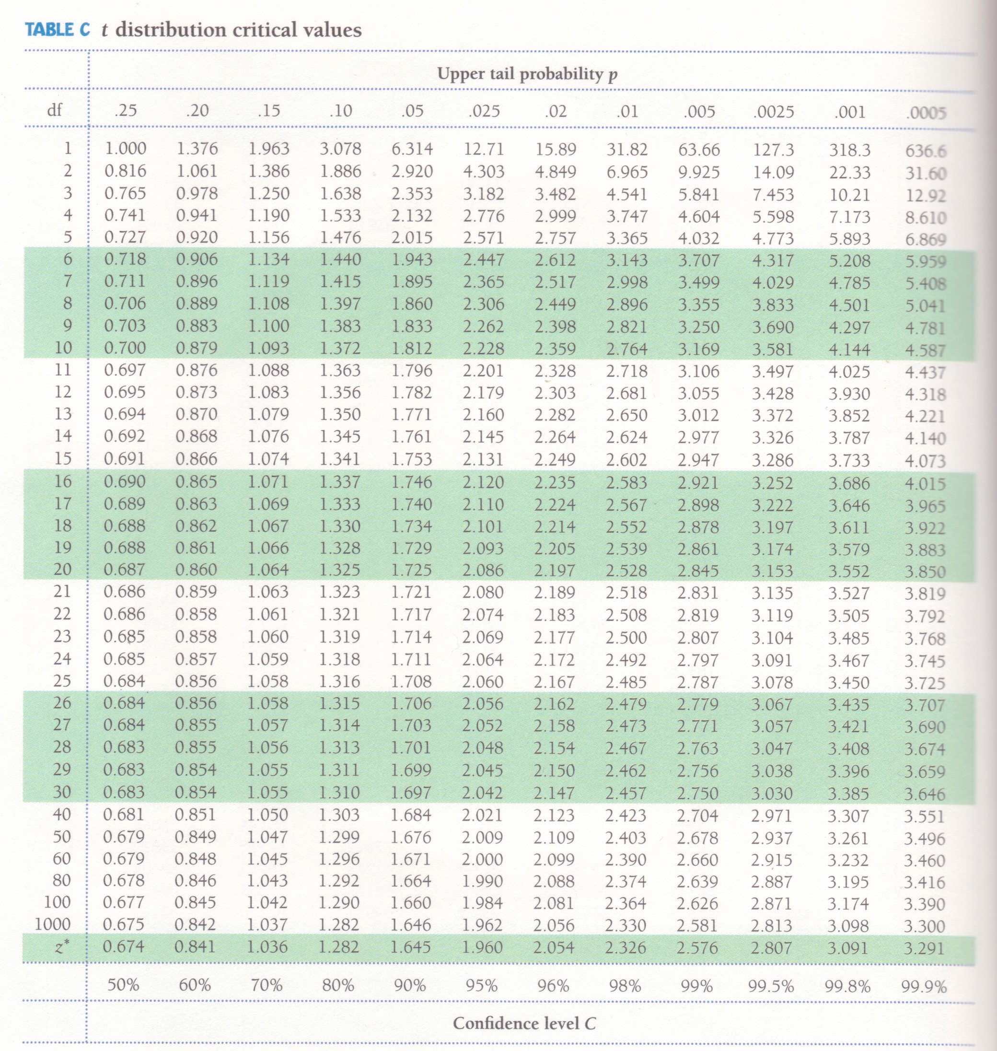
What is the 95% confidence interval for the average percent change?
Sample average = 5.5; s = 2.517; df = n − 1 = 8
(…)
The sampling distribution is a t distribution with n − 1 degrees of freedom.
For df = 8 and C = 95%, t* = 2.306.
The margin of error m is: m = t*s/√n = 2.306*2.517/√9 ≈ 1.93.
With 95% confidence, the population average percent increase in polyphenol blood levels of healthy men drinking half a bottle of red wine daily is between 3.6% and 7.6%.
Note: The confidence interval shows how large the potential increase is, but not whether it is an important effect that can have an impact on men’s health.

Slide 63
The one-sample t-test
As in the previous chapter, a test of hypotheses requires a few steps:
  Stating the null and alternative hypotheses (H₀ versus H_{a})
  Deciding on a one-sided or two-sided test
  Choosing a significance level α (and power)
  Calculating t-statistic and its degrees of freedom
  Finding the area under the curve with Table D or R
  Stating the P-value and interpreting the result

Slide 64
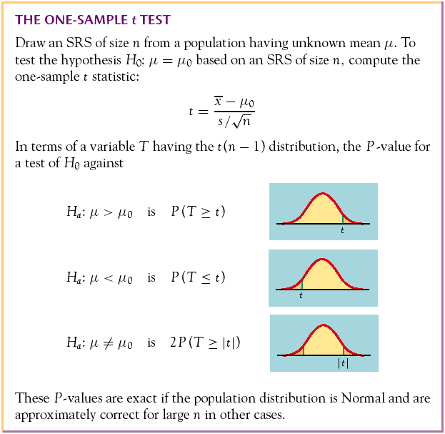
The P-value is the probability, if H₀ is true, of randomly drawing a sample like the one obtained or more extreme, in the direction of H_{a}.
The P-value is calculated as the corresponding area under the curve, one-tailed or two-tailed depending on H_{a}:
One-sided
(one-tailed)
Two-sided
(two-tailed)

Slide 65
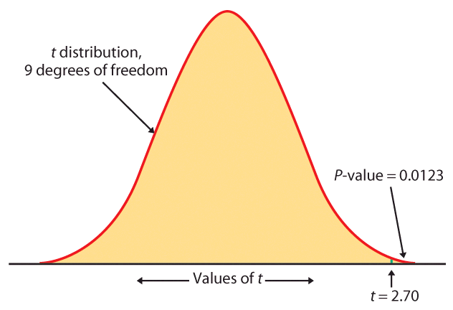
Table D
For df = 9 we only look into the corresponding row.
Suppose the calculated value of t is 2.7. We find the 2 closest t values.
2.398 < t = 2.7 < 2.821
thus
0.02 > upper tail p > 0.01
For a one-sided H_{a}, this is the P-value (between 0.01 and 0.02);
for a two-sided H_{a}, the P-value is doubled (between 0.02 and 0.04).

Slide 66
Phosphate in Blood:
We want to estimate the patient’s mean
phosphate level with a 95% confidence
interval in R
or we could want to test
H₀: μ = 4.9 versus H_{a}: μ > 0
If had known σ =.67, use Normal:
> 1-pnorm(1.718)
[1] 0.04289831

Slide 67
Matched pairs t procedures
Sometimes we want to compare treatments or conditions at the individual level. These situations produce two samples that are not independent — they are related to each other. The members of one sample are identical to, or matched (paired) with, the members of the other sample.
  Example: Pre-test and post-test studies look at data collected on the same sample elements before and after some experiment is performed.
  Example: Twin studies often try to sort out the influence of genetic factors by comparing a variable between sets of twins.
  Example: Using people matched for age, sex, and education in social studies allows canceling out the effect of these potential lurking variables.

Slide 68
In these cases, we use the paired data to test the difference in the two population means. The variable studied becomes X_{difference} = (X₁ − X₂), and
H₀: µ_{difference}= 0 ; H_{a}: µ_{difference}>0 (or <0, or ≠0)
Conceptually, this is not different from tests on one population.

Slide 69
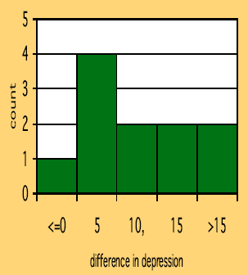
Does lack of caffeine increase depression?
Individuals diagnosed as caffeine-dependent are
deprived of caffeine-rich foods and assigned
to receive daily pills. Sometimes, the pills
contain caffeine and other times they contain
a placebo. Depression was assessed.
  There are 2 data points for each subject, but we’ll only look at the difference.
  The sample distribution appears appropriate for a t-test.
11 “difference”
data points.

Slide 70
Does lack of caffeine increase depression?
For each individual in the sample, we have calculated a difference in depression score (placebo minus caffeine).
There were 11 “difference” points, thus df = n − 1 = 10.
We calculate that = 7.36; s = 6.92
H₀: μ_{difference} = 0 ; H₀: μ_{difference} > 0
For df = 10, 3.169 < t = 3.53 < 3.581 ➔ 0.005 > p > 0.0025
Caffeine deprivation causes a significant increase in depression.

Slide 71
Robustness
The t procedures are exactly correct when the population is distributed exactly normally. However, most real data are not exactly normal.
The t procedures are robust to small deviations from normality – the results will not be affected too much. Factors that strongly matter:
  Random sampling. The sample must be an SRS from the population.
  Outliers and skewness. They strongly influence the mean and therefore the t procedures. However, their impact diminishes as the sample size gets larger because of the Central Limit Theorem.
Specifically:
  When n < 15, the data must be close to normal and without outliers.
  When 15 > n > 40, mild skewness is acceptable but not large outliers.
  When n > 40, the t-statistic will be valid even with strong skewness.

Slide 72
Inference for non-normal distributions
What if the population is clearly non-normal and your sample is small?
If the data are skewed, you can attempt to transform the variable to bring it closer to normality (e.g., logarithm transformation). The t- procedures applied to transformed data are quite accurate for even moderate sample sizes.
A distribution other than a normal distribution might describe your data well. Many non-normal models have been developed to provide inference procedures too.
You can always use a distribution-free (“nonparametric”) inference procedure (see chapter 15) that does not assume any specific distribution for the population. But it is usually less powerful than distribution-driven tests (e.g., t test).

Slide 73
Inference for Distributions
Comparing Two Means
© 2009 W.H. Freeman and Company

Slide 74
Objectives
Comparing two means
  Two-sample z statistic
  Two-samples t procedures
  Two-sample t significance test
  Two-sample t confidence interval
  Robustness
  Details of the two-sample t procedures

Slide 75
Comparing two samples
(A)
Population 1
Population 2
Sample 2
Sample 1
Which
is it?
We often compare two treatments used on independent samples.
Is the difference between both treatments due only to variations from the random sampling (B), or does it reflect a true difference in population means (A)?
(B)
Population
Sample 2
Sample 1
Independent samples: Subjects in one samples are completely unrelated to subjects in the other sample.

Slide 76
Two-sample z statistic (known σ’s)
We have two independent SRSs (simple random samples) possibly coming from two distinct populations with (μ₁,σ₁) and (μ₂,σ₂). We use ₁ and ₂ to estimate the unknown μ₁ and μ₂.
When both populations are normal, the sampling distribution of ( ₁− ₂) is also normal, with standard deviation :
Then the two-sample z statistic
has the standard normal N(0, 1)
sampling distribution.

Slide 77
Two independent samples t distribution
We have two independent SRSs (simple random samples) possibly coming from two distinct populations with (μ₁,σ₁) and (μ₂,σ₂) unknown. We use ( ₁,s₁) and ( ₂,s₂) to estimate (μ₁,σ₁) and (μ₂,σ₂), respectively.
To compare the means, both populations should be normally distributed. However, in practice, it is enough that the two distributions have similar shapes and that the sample data contain no strong outliers.

Slide 78
Whereas the two-sample z-statistic is N(0,1), the two-sample t statistic follows approximately the t distribution because we must now estimate the standard deviation for the sampling distribution of the difference in the sample means:
The t-statistic follows approximately a t-distribution with a mean of zero and
and a variance of df/(df-2).
Conservatively, the degrees of freedom is equal to the smallest of (n₁ − 1, n₂ − 1).

Slide 79
Two-sample t significance test
The null hypothesis is that both population means μ₁ and μ₂ are equal, thus their difference is equal to zero.
H₀: μ₁ = μ₂ <=> μ₁ − μ₂ = 0
with either a one-sided or a two-sided alternative hypothesis.
We find how many standard errors (SE) away
from (μ₁ − μ₂) is ( ₁− ₂) by standardizing with t:
Because in a two-sample test H₀
poses (μ₁ − μ₂) = 0, we simply use
With df = smallest(n₁ − 1, n₂ − 1)

Slide 80
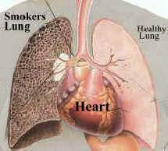
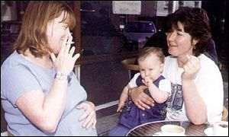
Does smoking damage the lungs of children exposed to parental smoking?
Forced vital capacity (FVC) is the volume (in milliliters) of air that an individual can exhale in 6 seconds.
FVC was obtained for a sample of children not exposed to parental smoking and a group of children exposed to parental smoking.
Parental smoking | FVC | s | n
Yes | 75.5 | 9.3 | 30
No | 88.2 | 15.1 | 30
We want to know whether parental smoking decreases children’s lung capacity as measured by the FVC test.
Is the mean FVC lower in the population of children exposed to parental smoking?

Slide 81
H₀: μ_{smoke} = μ_{no} <=> (μ_{smoke} − μ_{no}) = 0
H_{a}: μ_{smoke} < μ_{no} <=> (μ_{smoke} − μ_{no}) < 0 (one sided)
The t-statistic for the difference in sample averages follows approximately the t distribution. A conservative estimate of df is 29.
We calculate the t statistic:
Parental smoking | FVC | s | n
Yes | 75.5 | 9.3 | 30
No | 88.2 | 15.1 | 30
In table D, for df 29 we find:
|t| > 3.659 => p < 0.0005 (one sided)
It’s a very significant difference, we reject H₀.
Lung capacity is significantly impaired in children of smoking parents.

Slide 82
Two-sample t confidence interval
Because we have two independent samples we use the difference between both sample averages ( ₁ − ₂) to estimate (μ₁ − μ₂).
Practical use of t: t*
C is the area between −t* and t*.
We find t* in the line of Table D for df = smallest (n₁−1; n₂−1) and the column for confidence level C.
The margin of error m is:
C
−t*
t*

Slide 83
Common mistake !!!
A common mistake is to calculate a one-sample confidence interval for μ₁ and then check whether μ₂ falls within that confidence interval, or vice-versa.
This is WRONG because the variability in the sampling distribution for two independent samples is more complex and must take into account variability coming from both samples. Hence the more complex formula for the standard error.

Slide 84
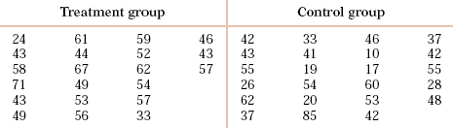

Can directed reading activities in the classroom help improve reading ability? A class of 21 third-graders participates in these activities for 8 weeks while a control classroom of 23 third-graders follows the same curriculum without the activities. After 8 weeks, all children take a reading test (scores in table).
95% confidence interval for (µ₁ − µ₂), with df = 20 conservatively → t* = 2.086:
With 95% confidence, (µ₁ − µ₂), falls within 9.96 ± 8.99 or 1.0 to 18.9.

Slide 85
Robustness
The two-sample t procedures are more robust than the one-sample t procedures. They are the most robust when both sample sizes are equal and both sample distributions are similar. But even when we deviate from this, two-sample tests tend to remain quite robust.
  ➔ When planning a two-sample study, choose equal sample sizes if you can.
As a guideline, a combined sample size (n₁ + n₂) of 40 or more will allow you to work with even the most skewed distributions.

Slide 86
Details of the two sample t procedures
The true value of the degrees of freedom for a two-sample t-distribution is quite lengthy to calculate. That’s why we use an approximate value, df = smallest(n₁ − 1, n₂ − 1), which errs on the conservative side (often smaller than the exact).
Computer software, though, gives the exact degrees of freedom—or the rounded value—for your sample data.

Slide 87
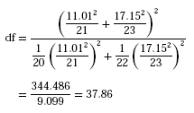
95% confidence interval for the reading ability study using the more precise degrees of freedom:
Independent Samples Test
Equal Variance Assumed
Equal Variance Not Assumed
t-test for Equality of Means
95% Confidence
Interval of the
SPSS
Mean
Std. Error
Difference
t
df
Sig. (2-tailed)
Difference
Difference
Lower
Upper
2.267
42
.029
9.95445
4.39189
1.09125
18.81765
2.311
37.855
.026
9.95445
4.30763
1.23302
18.67588

Slide 88
Which type of test? One sample, paired samples, two samples?
Comparing vitamin content of bread immediately after baking vs. 3 days later (the same loaves are used on day one and 3 days later).
Comparing vitamin content of bread immediately after baking vs. 3 days later (tests made on independent loaves).
Average fuel efficiency for 2005 vehicles is 21 miles per gallon. Is average fuel efficiency higher in the new generation “green vehicles”?
Is blood pressure altered by use of an oral contraceptive? Comparing a group of women not using an oral contraceptive with a group taking it.
Review insurance records for dollar amount paid after fire damage in houses equipped with a fire extinguisher vs. houses without one. Was there a difference in the average dollar amount paid?

