Slide 1
Enhancing Academic Success Prediction
Sreeja Cheekireddy
Mariah S Banu
Randall Krabbe
Laya Karimi
Shubhechchha Niraula

Slide 2
MOTIVATION & RESEARCH AIM
Challenge: Early identification of students at risk of failure/dropout to provide timely support and improve outcomes.
Motivation: Utilize data-driven approaches in education to facilitate personalized learning experiences.
Approach:
Input: Students' demographics, academic history, engagement metrics, and economic context.
Method: XGBoost, Random forest, SVM, K-means Clustering, Deep learning
Output: Predictive score indicating the likelihood of academic success or failure.
Process:
Data pre-processing for quality and consistency.
Feature selection to identify the most relevant predictors.
Model training and evaluation against historical performance.
Deployment for real-time prediction and intervention.
Impact: Aims to enhance resource allocation, personalize student support, and ultimately, increase retention rates.

Slide 3
PAST RESEARCH
Research on dropout prediction of students enrolled in undergraduate courses of Polytechnic Institute of Portalegre, Portugal. The dataset is the records of students enrolled between the academic years 2008/09–2018/2019 and from different undergraduate degrees[2].
Each record was classified as Success, Relative Success, and Failure, depending on the time that the student took to obtain her degree[2]
Logistic Regression (LR), Support Vector Machines (SVM), Decision Trees (DT), and an ensemble method, Random Forests (RF).
Boosting Classifications: Gradient Boosting, Extreme Gradient Boosting, Logit Boost, CatBoost
Best result achieved by the past research [2]:

Slide 4
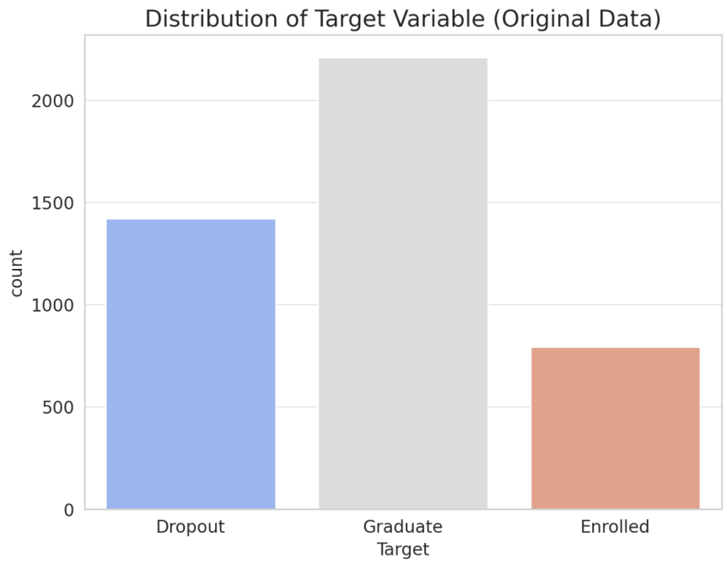
Dataset and Features
Dataset Composition: The dataset comprises various features such as 'Admission grade', 'Age at enrollment', 'Unemployment rate', 'Inflation rate', and 'GDP', which are instrumental in predicting student outcomes.
Data Preprocessing:
Encoding: Categorical variables were encoded to numeric values to facilitate model processing.
Handling Missing Values: Implemented strategies to deal with incomplete data entries, ensuring robust model input.
Data Cleaning: Performed necessary steps to clean the data, including removing irrelevant features and standardizing feature scales.
Class Imbalance Mitigation

Slide 5
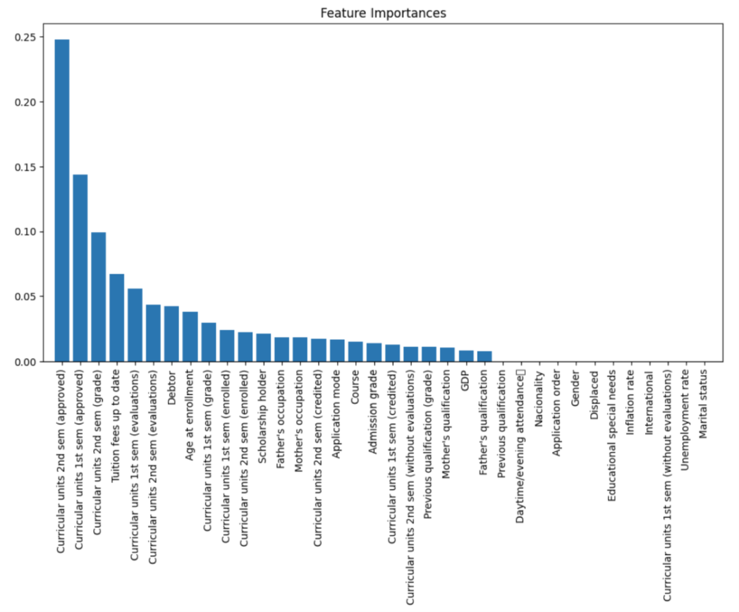
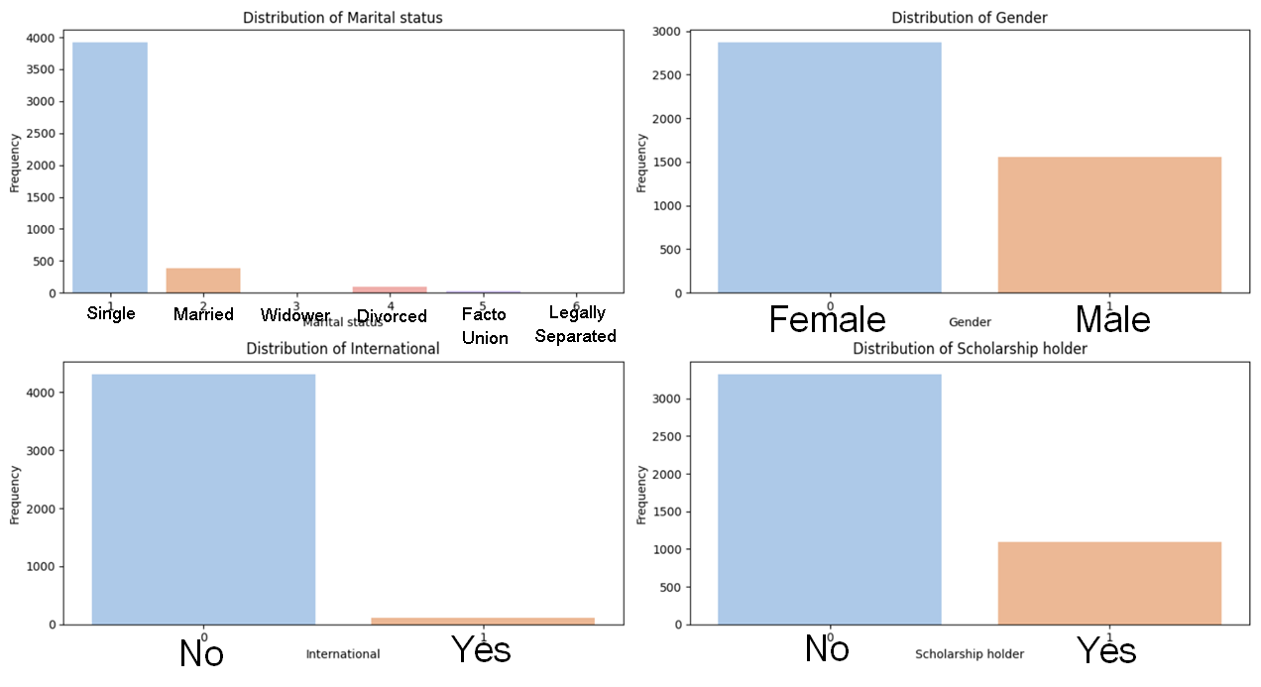
Dataset and Features
Citation: M.V.Martins, D. Tolledo, J. Machado, L. M.T. Baptista, V.Realinho. (2021) "Early prediction of student’s performance in higher education: a case study" Trends and Applications in Information Systems and Technologies, vol.1, in Advances in Intelligent Systems and Computing series. Springer. DOI: 10.1007/978-3-030-72657-7_16

Slide 6
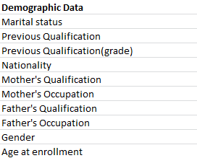
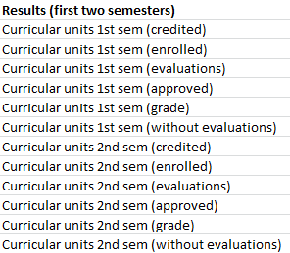
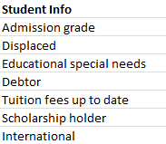
Dataset and Features

Slide 7
METHODS
Deep Learning
Ensemble
model
SVM
Random
Forest
XGBOOST

Slide 8
Results

Slide 9
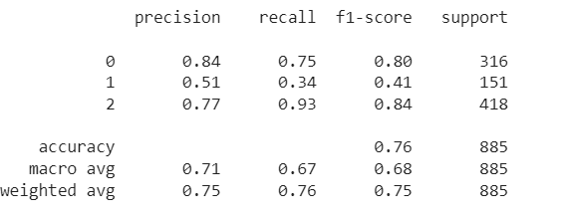
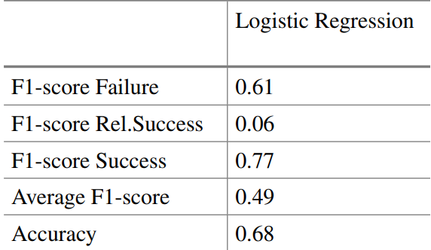
RESULTS: XGBoost Method
Metrics and Feature Prioritization
Evaluation Metrics: Accuracy, Recall, F1 Score, and Log Loss were chosen for comprehensive performance analysis.
Baseline Model vs. Advanced Model:
Simple logistic regression achieved 68% accuracy.
XGBoost: Improved accuracy to 76% by using GridSearch CV
Class 0: Dropout , class 1:Enrolled , and class 2: Graduate

Slide 10
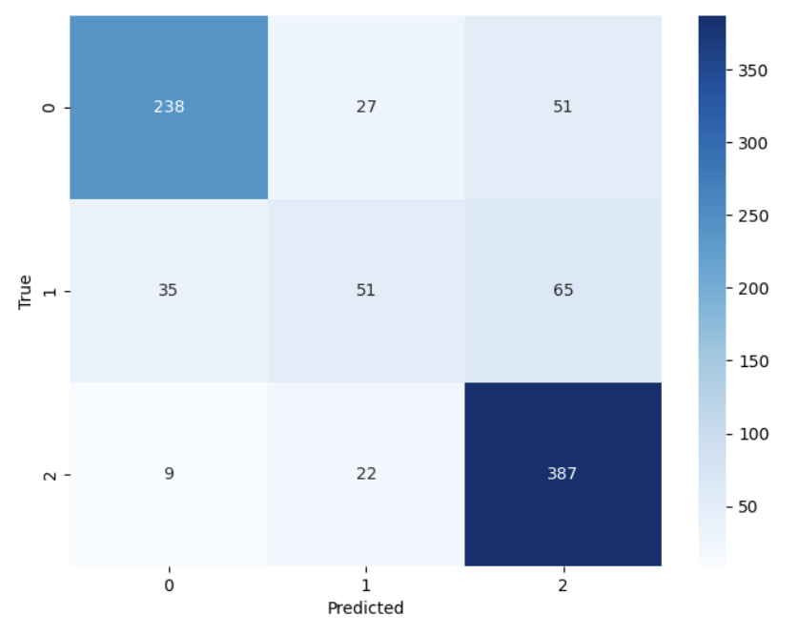
RESULTS: XGBoost Method

Slide 11
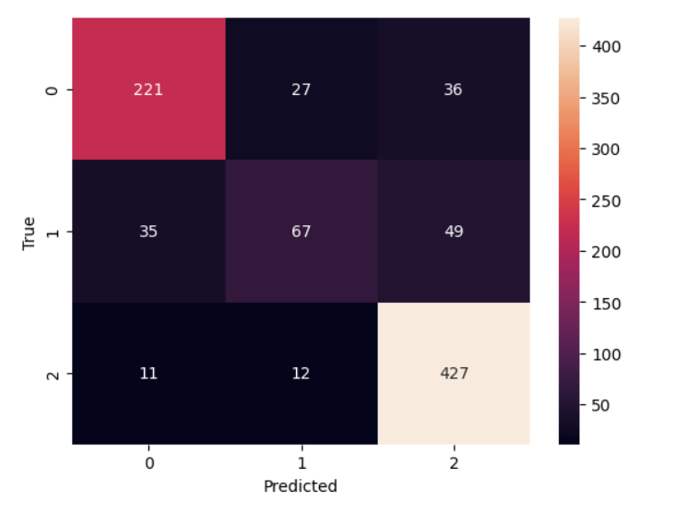
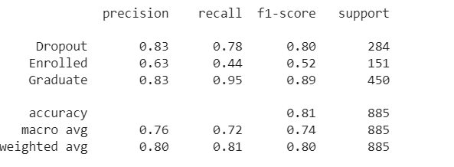
Results: Random-Forest Method
Test Accuracy: 80.79

Slide 12
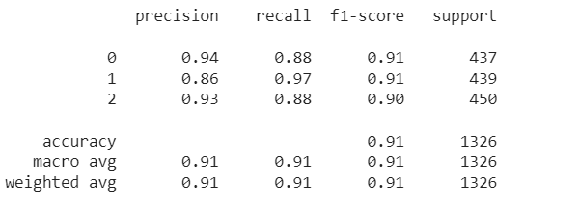
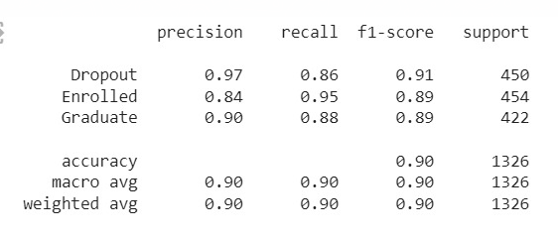
Results: XGBoost & Random Forest Methods with Data Augmentation
Data augmentation was done using oversampling
XG boost results on oversampling
Random forest results on oversampling
Class 0: Dropout , class 1:Enrolled , and class 2: Graduate

Slide 13
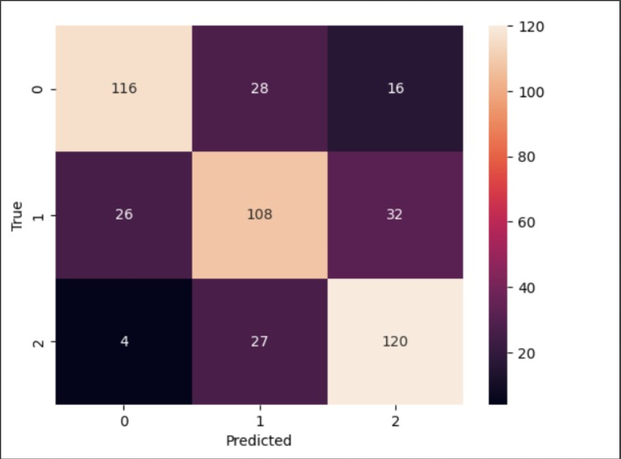
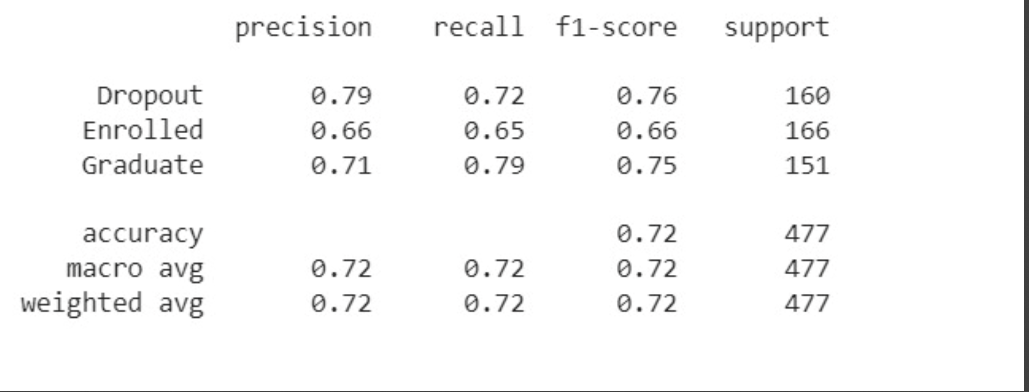
Results: Random Forest using Under-sampling

Slide 14
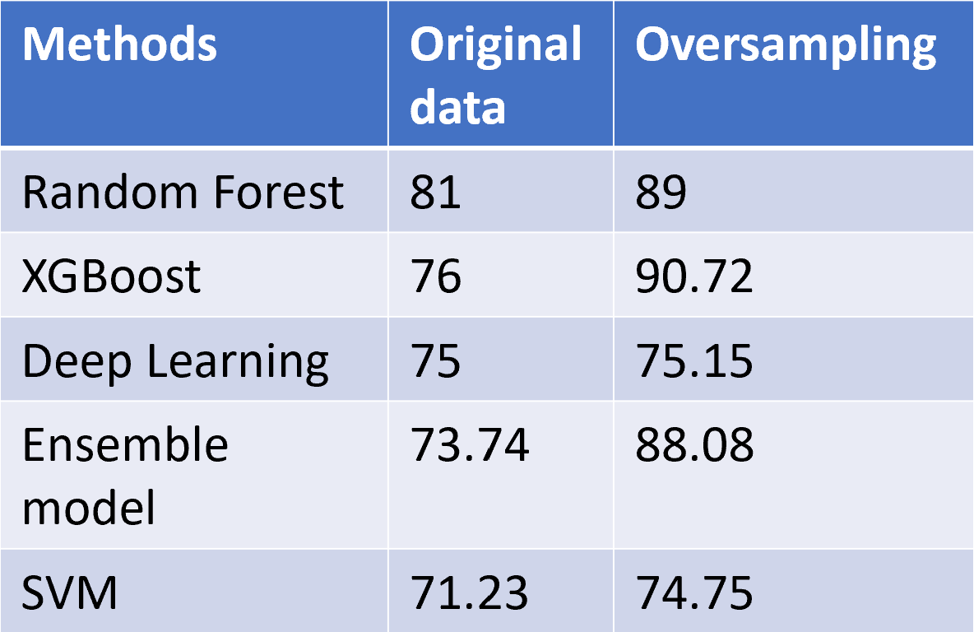
Results: Accuracy Comparison for All of our Methods

Slide 15
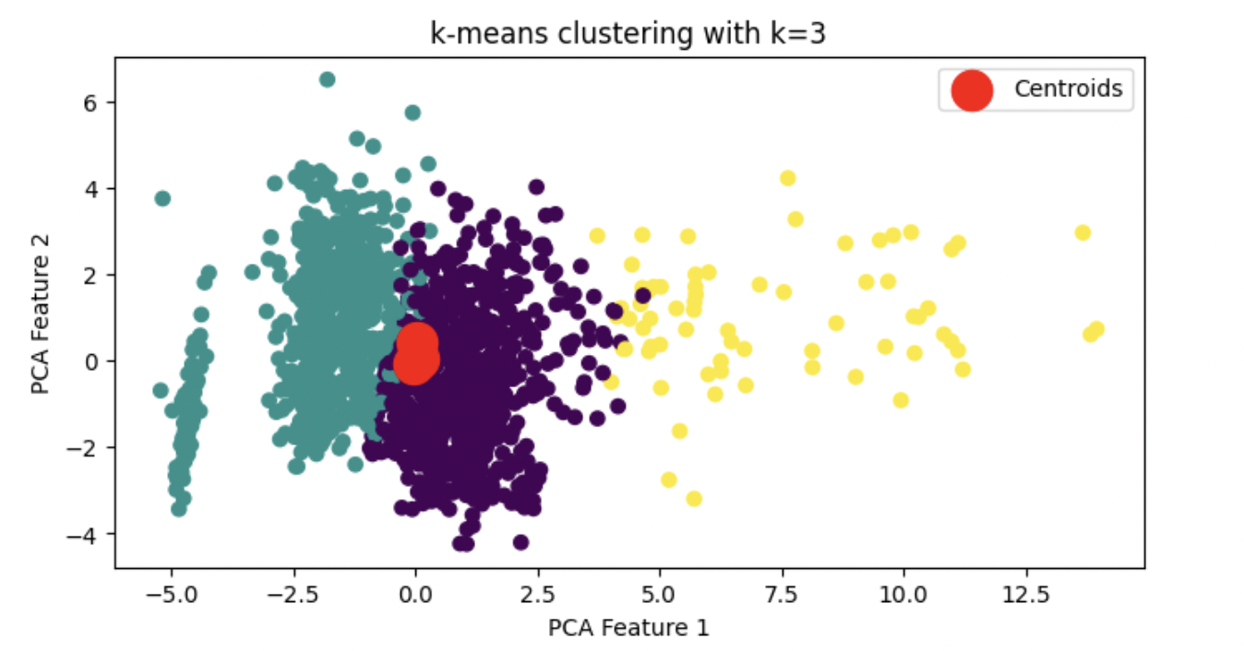
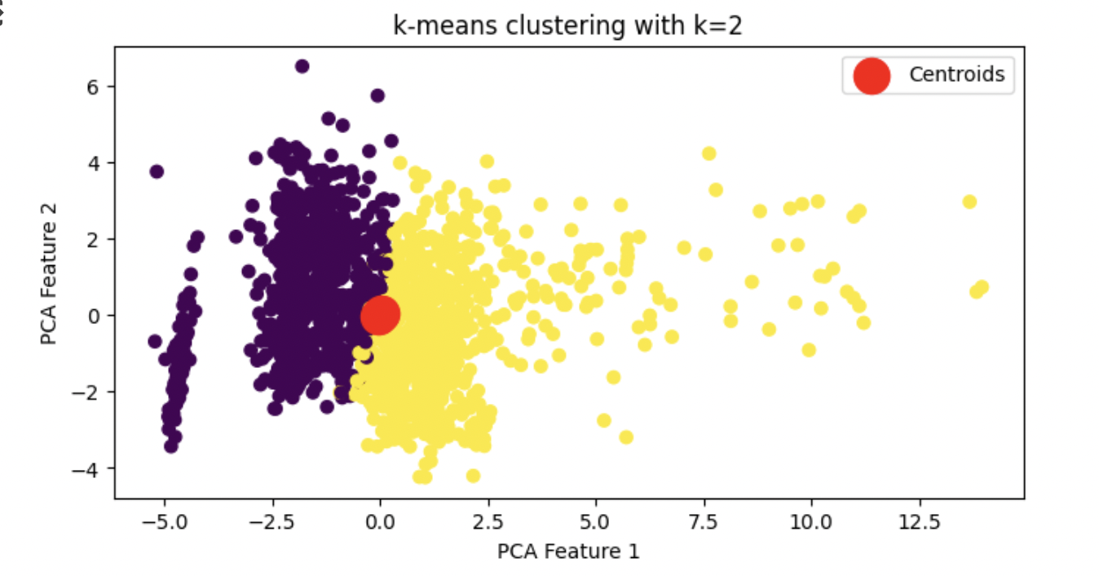
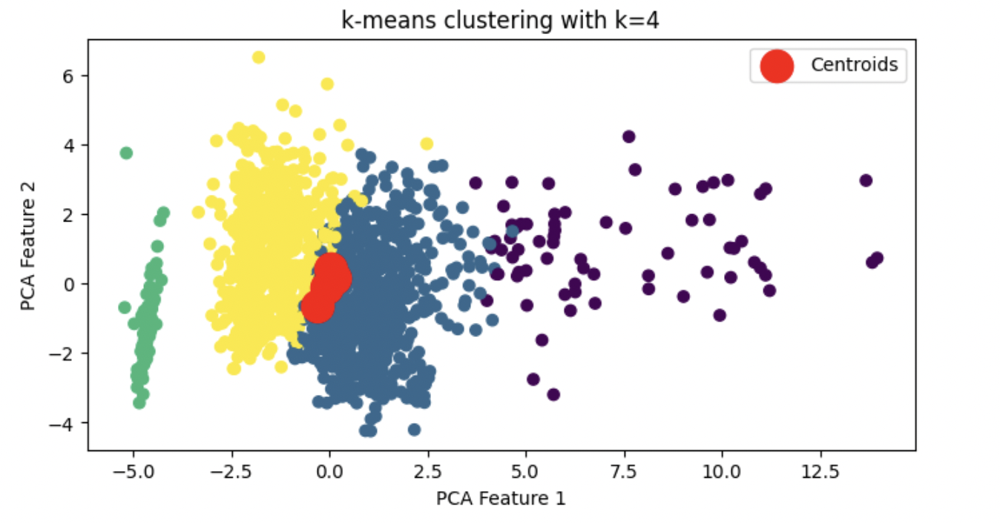
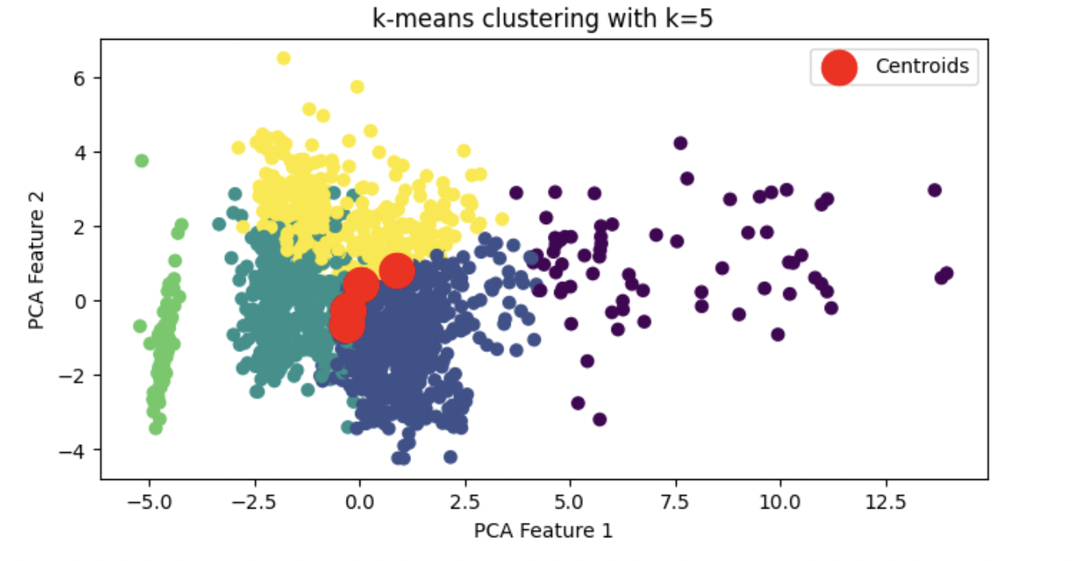
Results: K-means Method

Slide 16
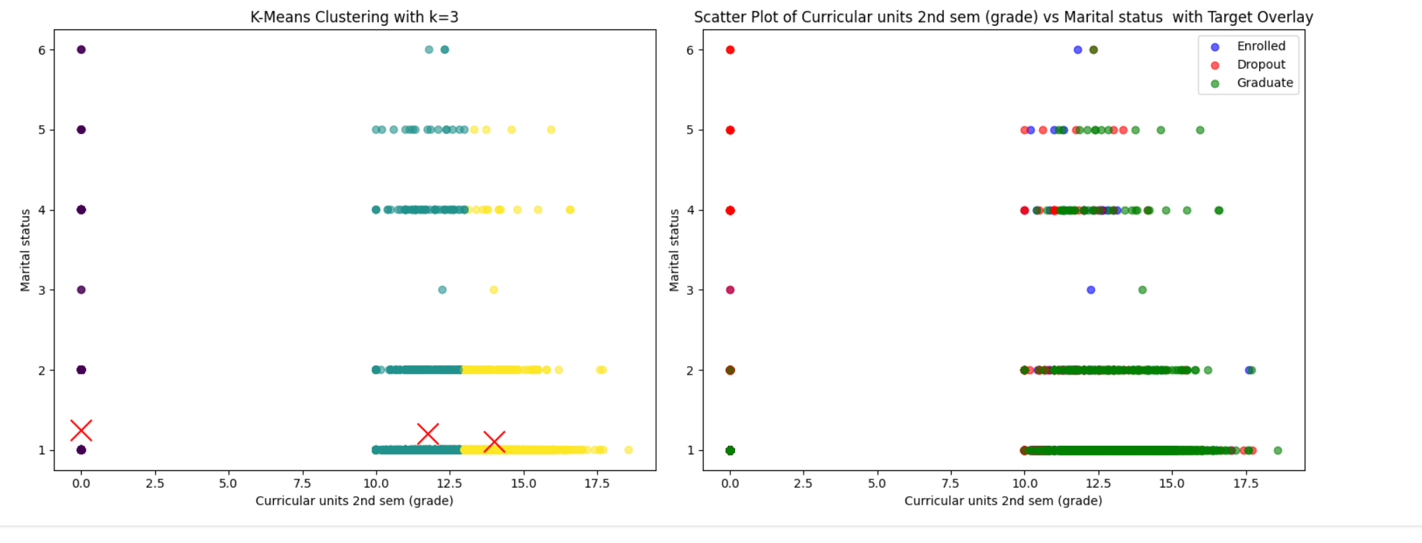
RESULTS: K-Means Method

Slide 17
RESULTS: K-Means Method

Slide 18
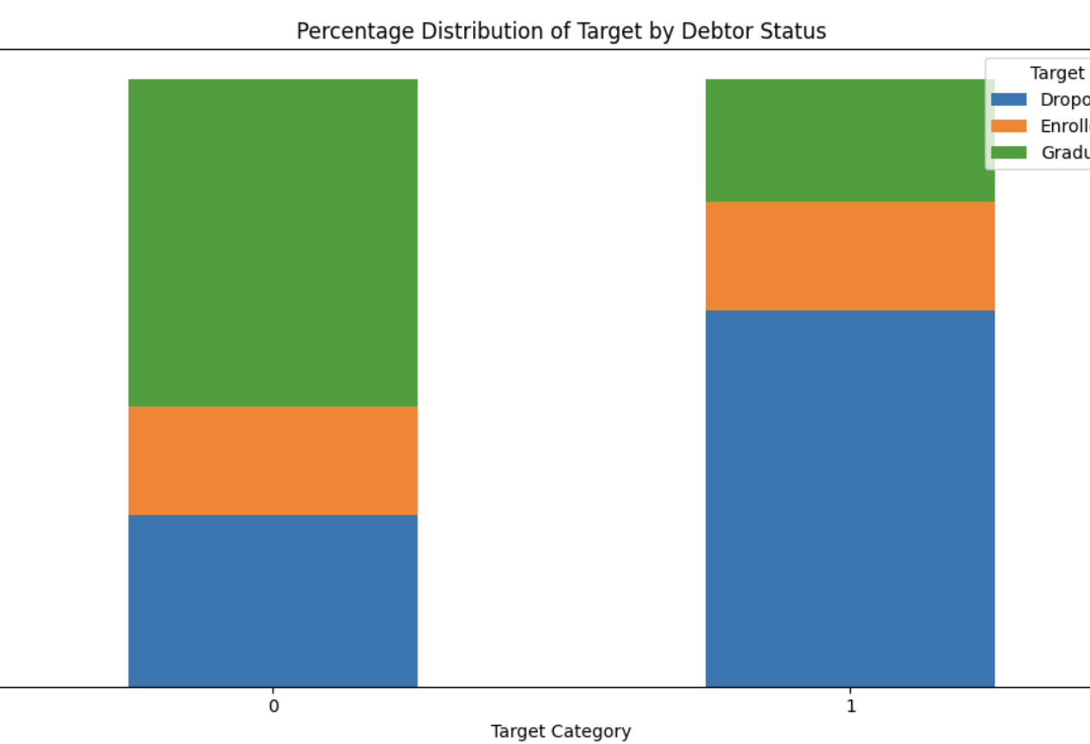
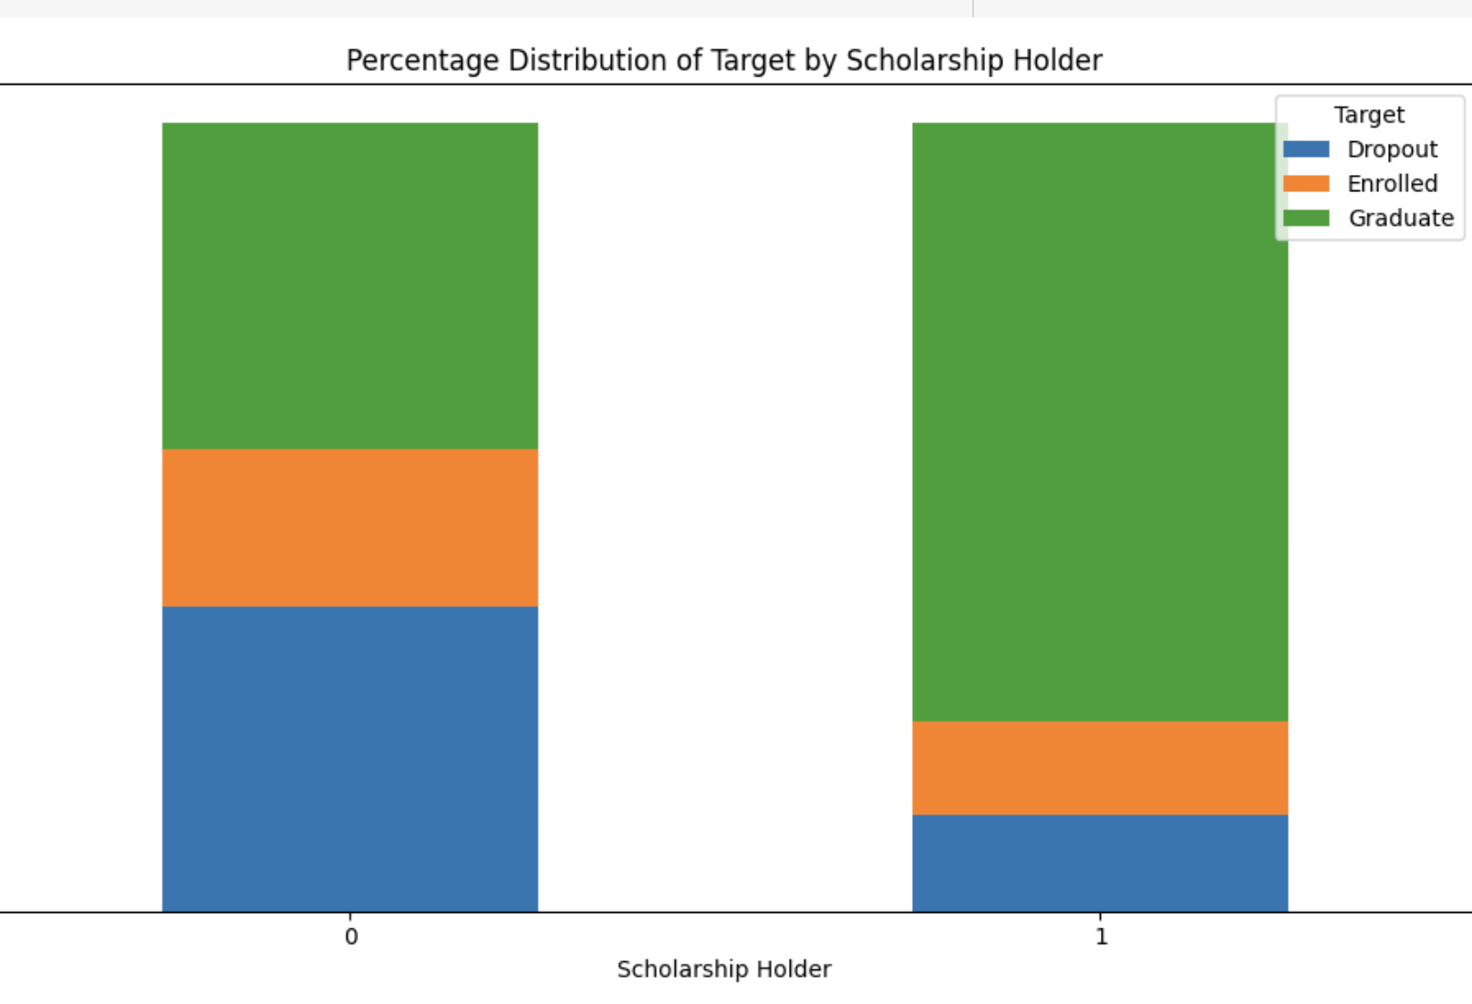
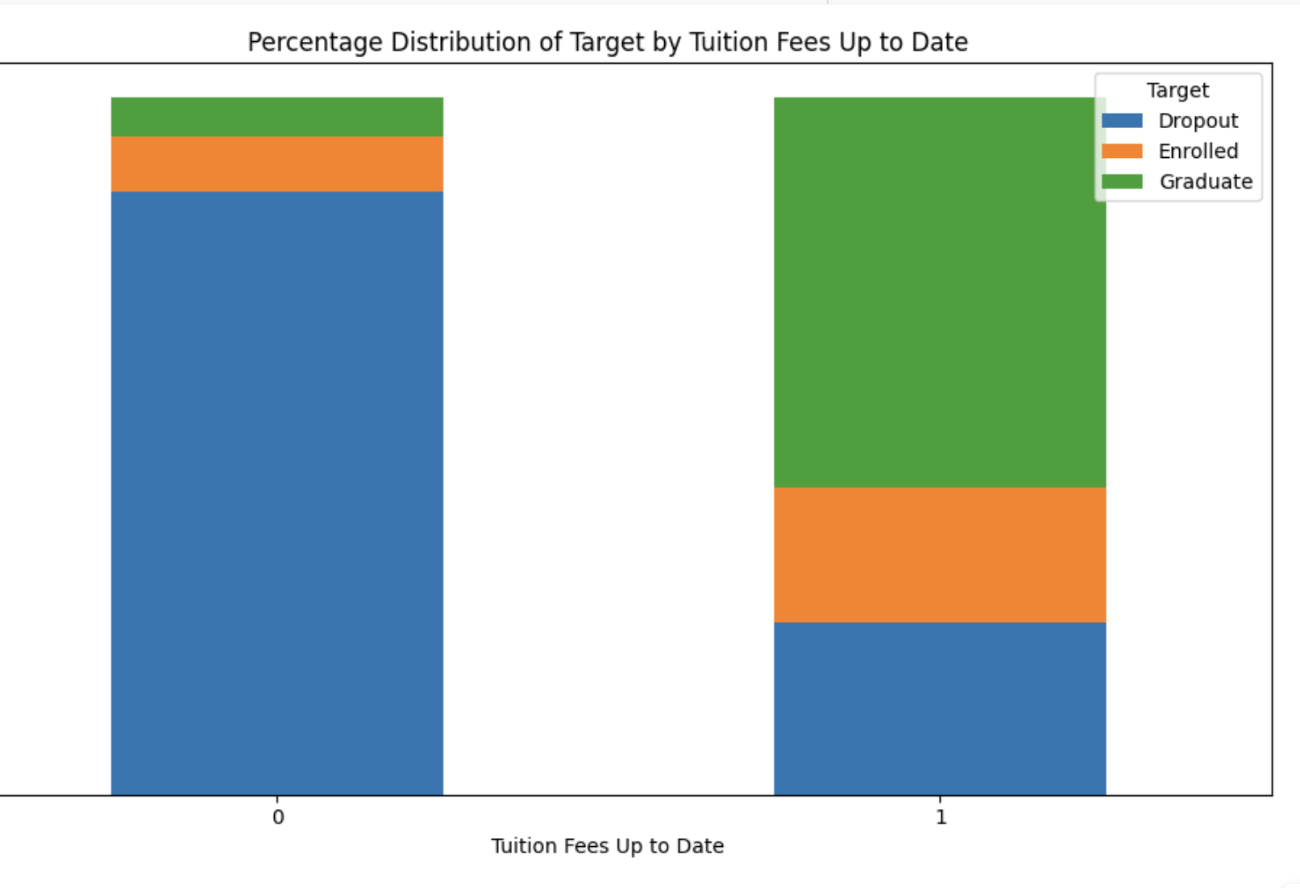
Results: INFERENCE

Slide 19
Future steps
Try to modify(make new)dataset with less categorical data
Make the SIUE dataset and implement the models using the same.
Make a common application for all colleges to use and identify the at-risk students
Recognize at-risk students and try to help them through student organizations.

Slide 20
References
M.V.Martins, D. Tolledo, J. Machado, L. M.T. Baptista, V.Realinho. (2021) "Early prediction of student’s performance in higher education: a case study" Trends and Applications in Information Systems and Technologies, vol.1, in Advances in Intelligent Systems and Computing series. Springer. DOI: 10.1007/978-3-030-72657-7_16
Sara, N. B., Halland, R., Igel, C., & Alstrup, S. (2015). High-School Dropout Prediction Using Machine Learning: A Danish Large-scale Study. In ESANN (Vol. 2015, p. 23rd).
Aulck, L., Velagapudi, N., Blumenstock, J., & West, J. (2016). Predicting student dropout in higher education. arXiv preprint arXiv:1606.06364.
Del Bonifro, F., Gabbrielli, M., Lisanti, G., & Zingaro, S. P. (2020). Student dropout prediction. In Artificial Intelligence in Education: 21st International Conference, AIED 2020, Ifrane, Morocco, July 6–10, 2020, Proceedings, Part I 21 (pp. 129-140). Springer International Publishing.
Tan, M., & Shao, P. (2015). Prediction of student dropout in e-Learning program through the use of machine learning method. International journal of emerging technologies in learning, 10(1).
Lee, S., & Chung, J. Y. (2019). The machine learning-based dropout early warning system for improving the performance of dropout prediction. Applied Sciences, 9(15), 3093.

