Slide 1
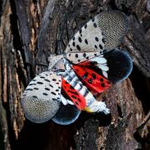
Tracking the Spread of the Invasive Spotted Lanternfly
Final Presentation
Team: George Lynch
Krishna Khanal
Sushrit Kafle
Venkatesh Bollineni

Slide 2
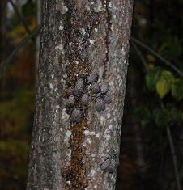
Motivation and Research Aim
Invasive species
Increasingly problematic
Economic/Agricultural costs
Ecosystem costs
EX: Emerald Ash Borer Beetle
100 million dead trees in the first 8 years of monitoring in Michigan
99% of ash trees in Oregon are now affected (Trent, 2022)
Relatively new establishment, yet numbers are troubling
Our Method:
Input: Year
Use Random Forest & Logistic Regression to output a predicted lyde density
Oozing wounds and adult SLF on a tree Photo: Pennsylvania Department of Agriculture, bugwood.org

Slide 3
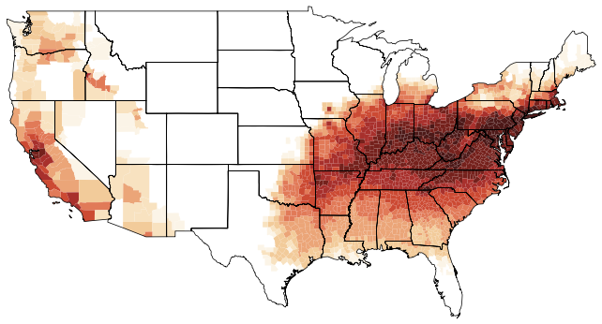
Related Work
Jones et al. 2022
Spotted Lantern Fly
Process-based model
Competitive against MaxEnt
Zhang, Wang, & Lei 2022
Asian Longhorn Beetle
MaxEnt models of ALB & enemy spp. for future introductions
Formoso-Freire et al. 2023
Spotted Lanternfly
Modified SDMs
Ramazi et al. 2021
Mountain Pine Beetle
1,3,5,7 years w 9 ML models
Naïve Bayes & NN performed better with increased history-lengths
Palma et al. 2023
Aphid
Pattern-Based Prediction method
Competitive SVM, DNN, LSTM, & Random Forests
PoPs Predicted distribution in 2050 (Jones et al. 2022)

Slide 4
Work flow

Slide 5
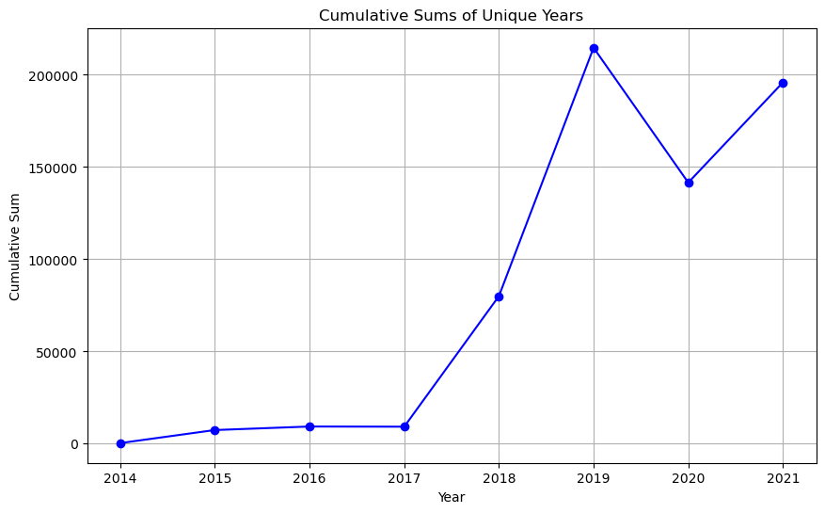
Materials and Methods
lydemapr: an R package
A dataframe with 658,390 observations and 14 variables
Train data <= 2020; Test data == 2021
Data preprocessing:
- Feature selection
- One-hot encoding, label encoding
- Imputing missing variables
- Addition of avg_temp column using data from NOAA National Centers for Environmental information
https://www.ncei.noaa.gov/access/monitoring/climate-at-a-glance/statewide/time-series

Slide 6
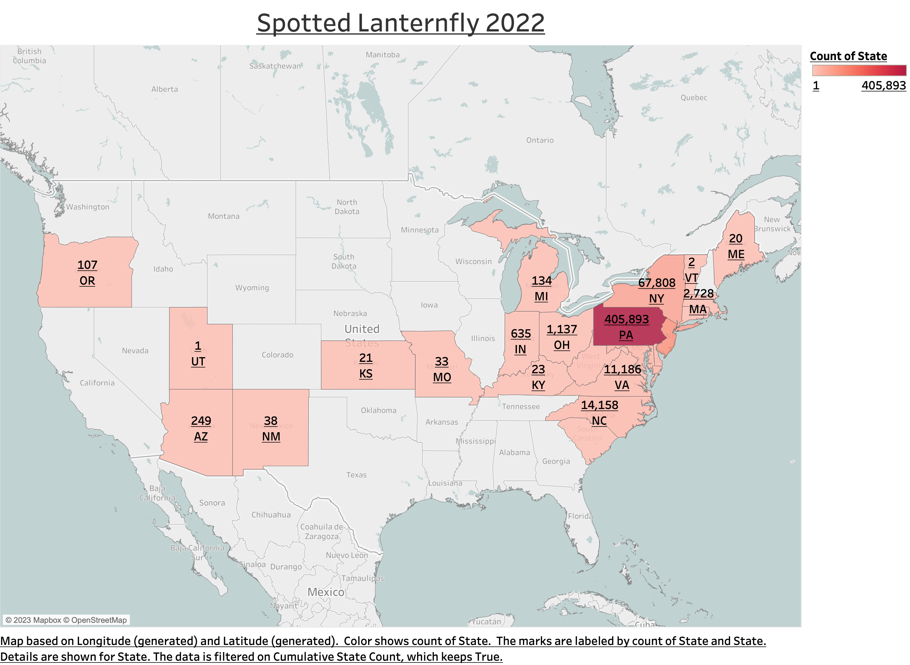
Dataset and Features – SLF Population

Slide 7
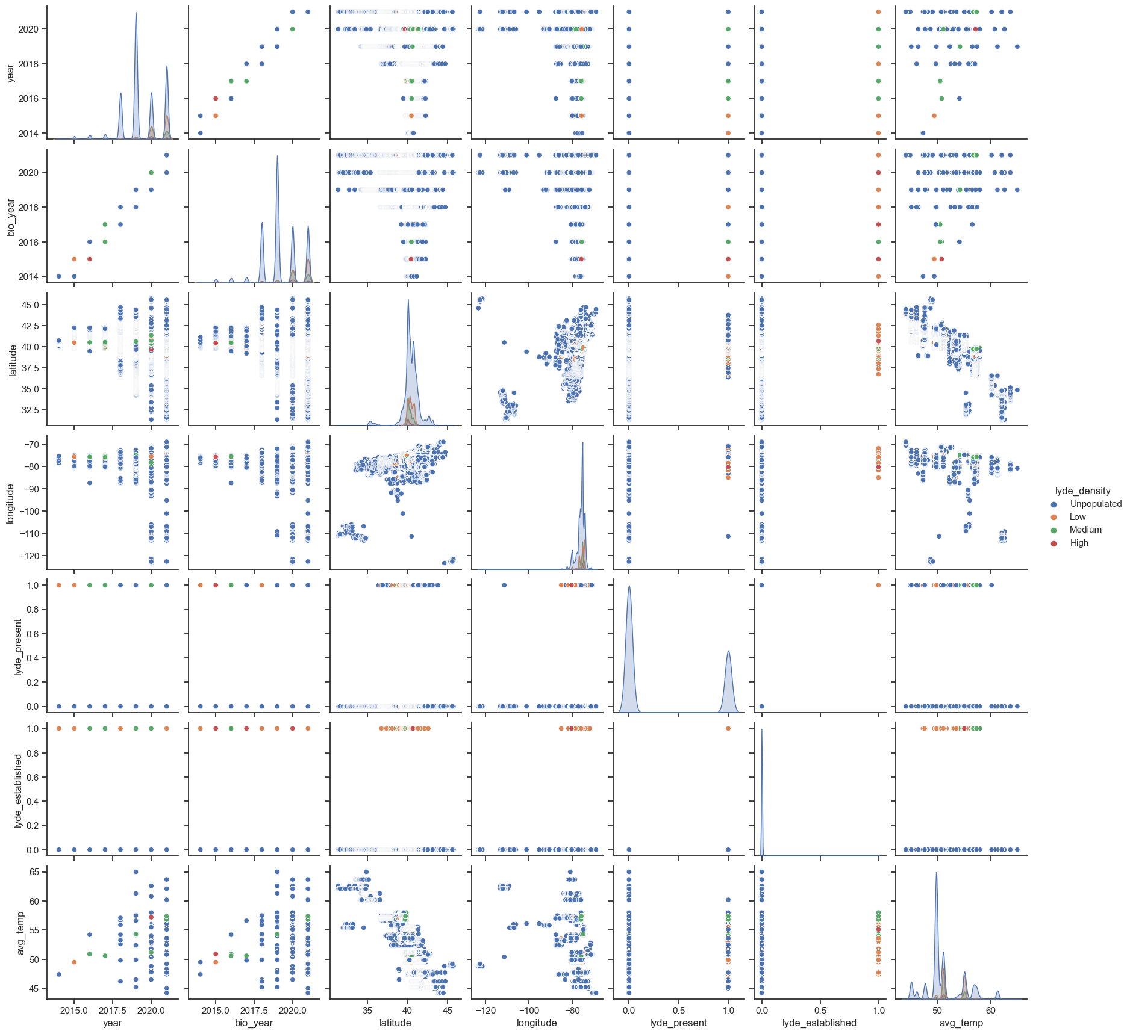
Dataset and Features - Selected features and correlations

Slide 8
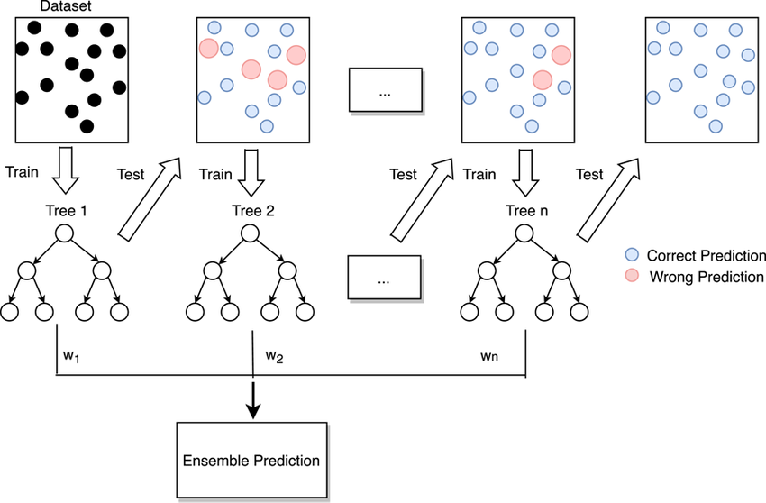
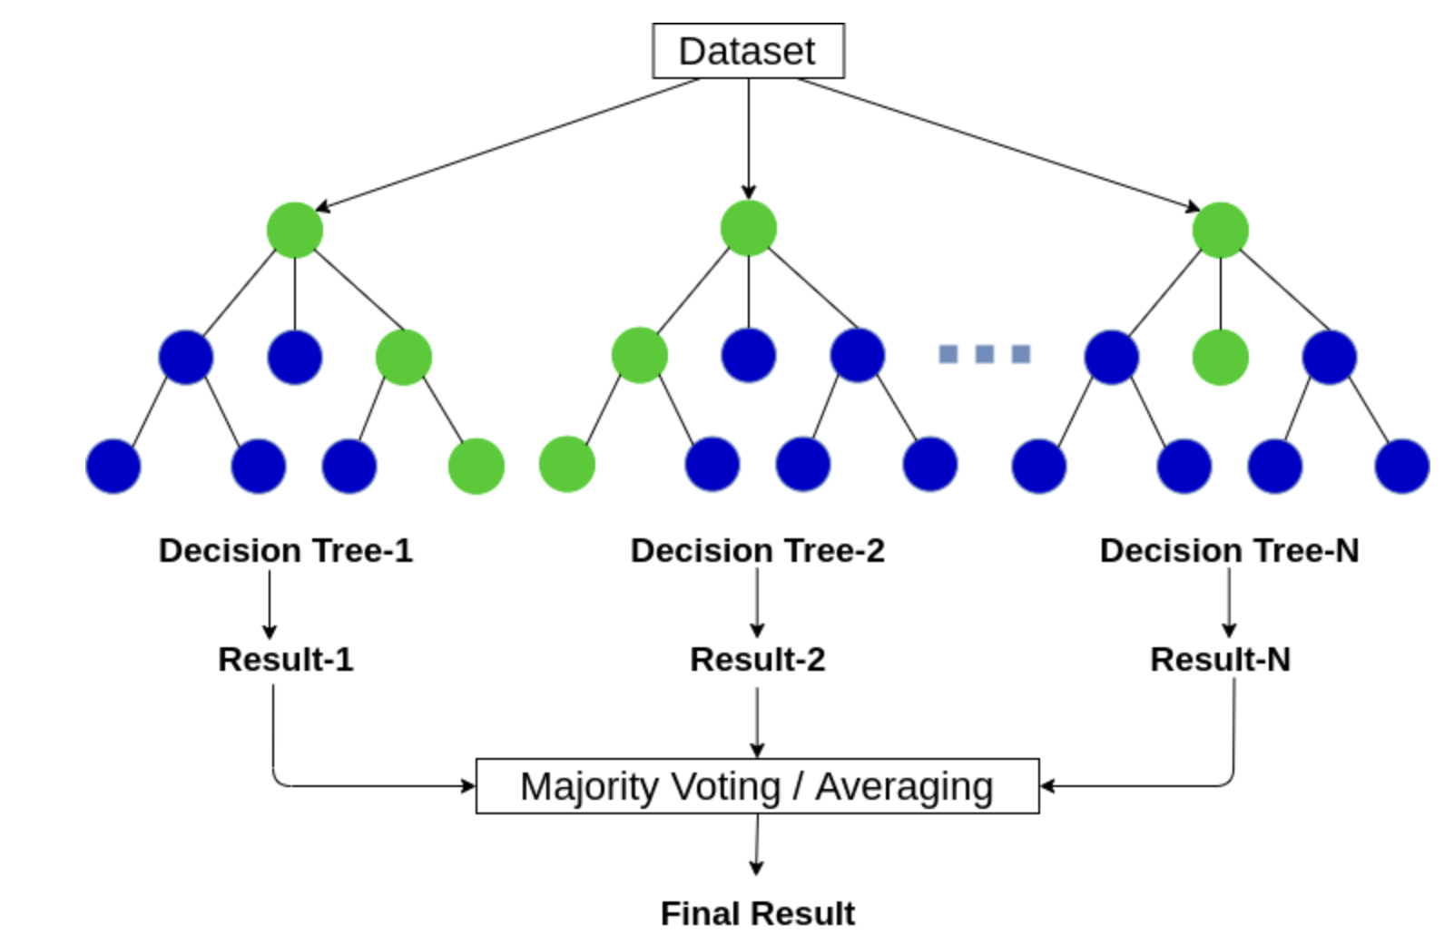
Methods
Learning Algorithms:
Random Forest Classifier:
Gradient Boosting
https://www.analyticsvidhya.com/blog/2021/05/bagging-25-questions-to-test-your-skills-on-random-forest-algorithm/
https://www.researchgate.net/figure/Flow-diagram-of-gradient-boosting-machine-learning-method-The-ensemble-classifiers_fig1_351542039
Notes:
n_estimatorsint, default=100 criterion{“gini”, “entropy”, “log_loss”}, default=”gini”

Slide 9
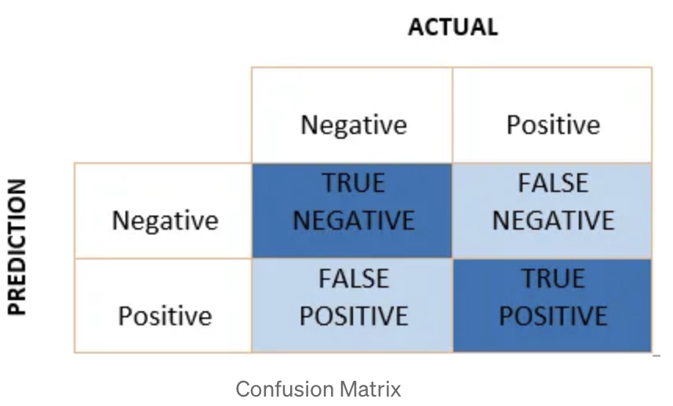
Methods - Evaluation Metrics
Precision
% of True Positive out of Positive Prediction
Recall
Out of total positive, % of predicted positive
Confusion Matrix
https://towardsdatascience.com/performance-metrics-confusion-matrix-precision-recall-and-f1-score-a8fe076a2262

Slide 10
Results
Models we tried:
Gradient Boosting with k-fold cross validation (87.8%)
Gradient Boosting with Cross validation and Oversampling (87.11%)
Ensemble Method using Random forest and Gradient boosting (81.2%)
GBoost Model (with Oversampling) (87.11%)
Ensemble Model (RFC + XGB) (with Oversampling) (78.66%)
Random Forest Model (with SMOTE) (72.65%)
Random Forest Model (with Equal Proportions) (73.44%)
Gradient Boosting without the most important feature 'lyde_established’ (62.22%)
Gradient Boosting (with Oversampling)
Trained on data <= 2020
Tested on data == 2021
Testing Accuracy: 87.11%

Slide 11
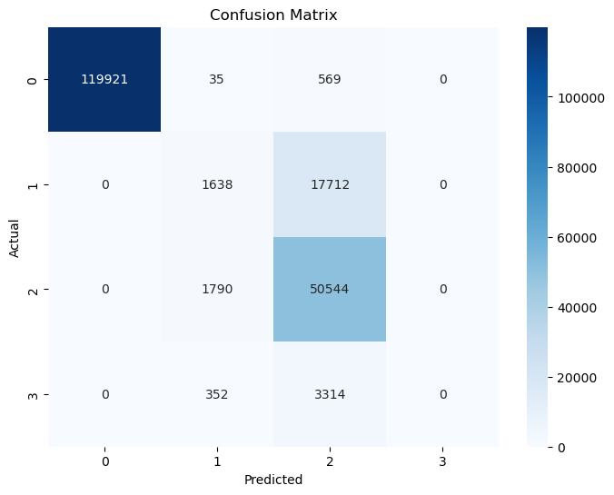
Results
0 - Unpopulated
1 - Low
2 - Medium
3 - High
Gradient Boosting with Oversampling
Gradient Boosting

Slide 12
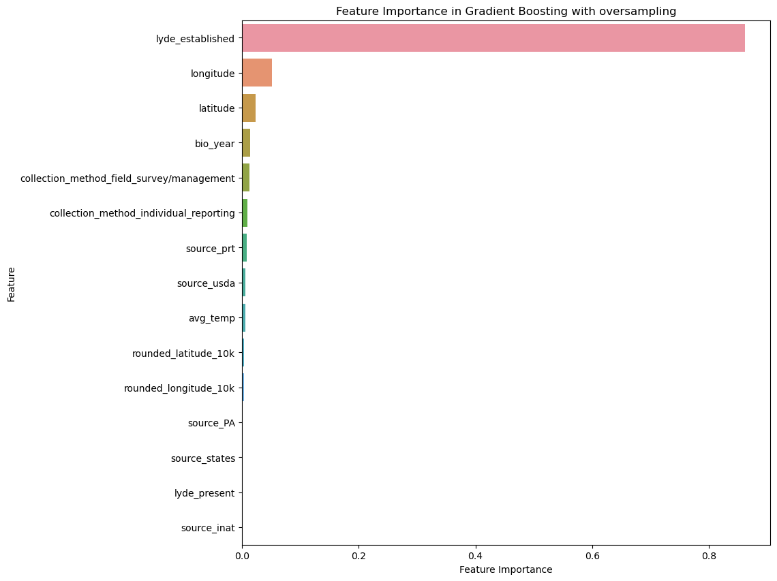
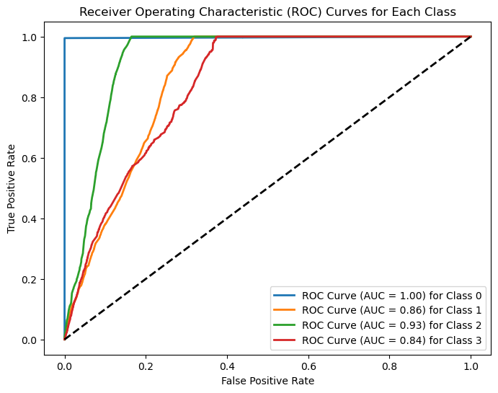
Results
0 - Unpopulated
1 - Low
2 - Medium
3 - High
FIG: ROC for Gradient Boosting Classifier with oversampling
FIG: Feature Importance for Gradient Boosting Classifier with oversampling

Slide 13
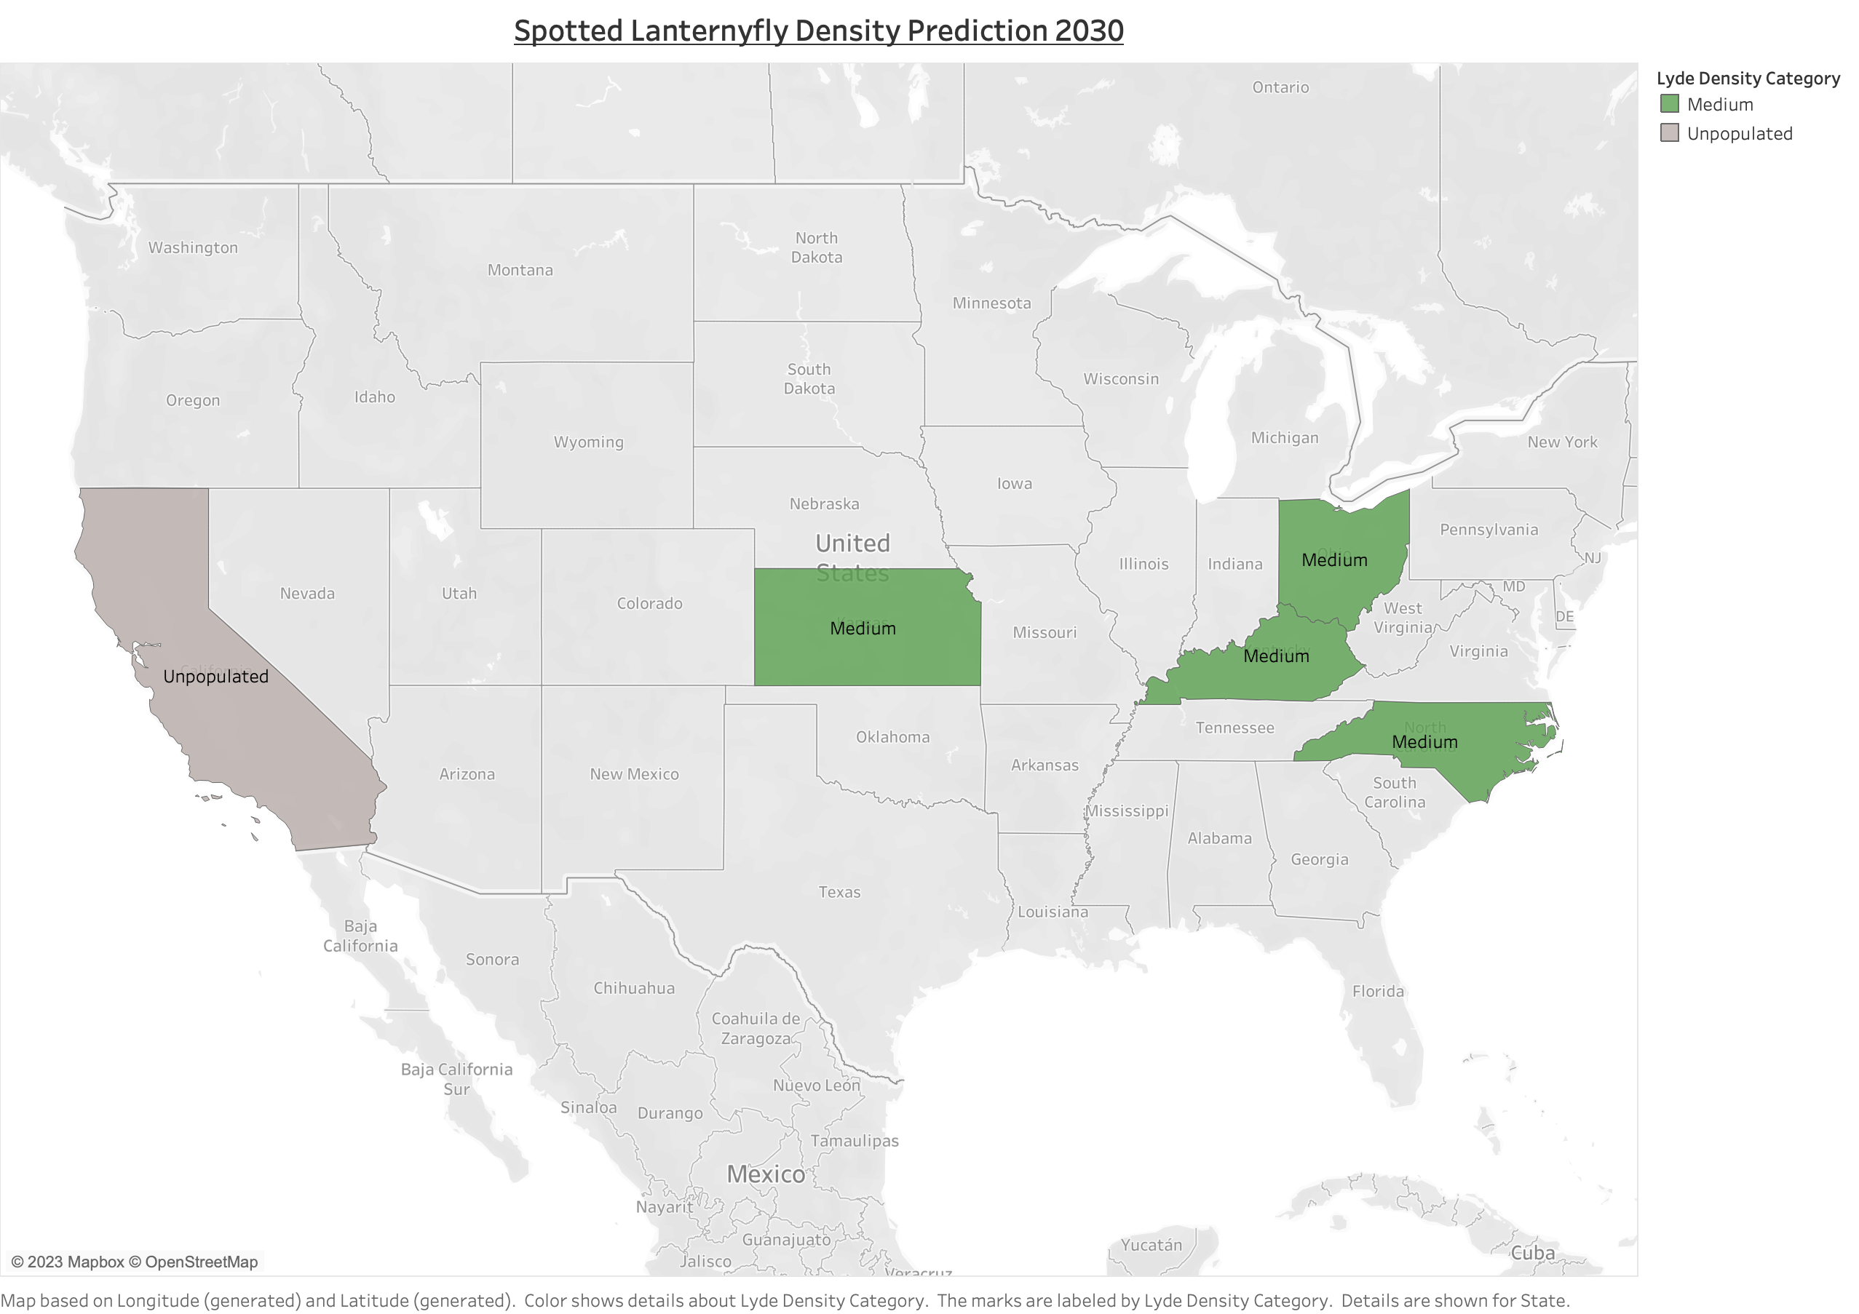
Results – Prediction for the year 2030
Models applied:
Gradient Boosting with OS
Random Forest
Random Forest with OS

Slide 14
Discussions and interesting facts
Why is the model not improving accuracy with oversampling of imbalanced classes? Is the model suffering from class overlapping ?
Features importance – are the features informative and correlated to target variable ?
What kind of features are to be included in the dataset to further increase the metrics ?

Slide 15
REFERENCES
Animal and Plant Health Inspection Service, U.S. Department of Agriculture; https://www.aphis.usda.gov/aphis/resources/pests-diseases/hungry-pests/the-threat/spotted-lanternfly/spotted-lanternfly
Department of Environmental Conservation, Spotted Lanternfly, https://www.dec.ny.gov/animals/113303.html
Formoso-Freire, V., Barbosa, A. M., Baselga, A., & Gómez-Rodríguez, C. (2023). Predicting the spatio-temporal pattern of range expansion under lack of equilibrium with climate. Biological Conservation, 288, 110361.
Jones, C., Skrip, M.M., Seliger, B.J. et al. Spotted lanternfly predicted to establish in California by 2033 without preventative management. Commun Biol 5, 558 (2022). https://doi.org/10.1038/s42003-022-03447-0
lydemapr: an R package to track the spread of the invasive Spotted Lanternfly (Lycorma delicatula, White 1845) (Hemiptera, Fulgoridae) in the United States, Sebastiano De Bona, Lawrence Barringer, Paul Kurtz, Jay Losiewicz, Gregory R. Parra, Matthew R. Helmus, bioRxiv 2023.01.27.525992; doi: https://doi.org/10.1101/2023.01.27.525992
Palma, G. R., Godoy, W. A., Engel, E., Lau, D., Galvan, E., Mason, O., ... & Moral, R. A. (2023). Pattern-based prediction of population outbreaks. Ecological Informatics, 77, 102220.
Paninvasion severity assessment of a U.S. grape pest to disrupt the global wine market, Nicholas A. Huron, Jocelyn E. Behm, Matthew R. Helmus, bioRxiv 2021.07.19.452723; doi: https://doi.org/10.1101/2021.07.19.452723
Ramazi, P., Kunegel‐Lion, M., Greiner, R., & Lewis, M. A. (2021). Predicting insect outbreaks using machine learning: A mountain pine beetle case study. Ecology and evolution, 11(19), 13014-13028.
Trent, Sarah. (2022, July 18). The most destructive Forest Pest in North America is now in Oregon. High Country News – Know the West. https://www.hcn.org/articles/north-forests-the-most-destructive-forest-pest-in-north-america-is-now-in-oregon
Zhang, Q. C., Wang, J. G., & Lei, Y. H. (2022). Predicting distribution of the Asian longhorned beetle, anoplophora glabripennis (Coleoptera: Cerambycidae) and its natural enemies in China. Insects, 13(8), 687.

Slide 16
QUESTIONS ?

