Slide 1
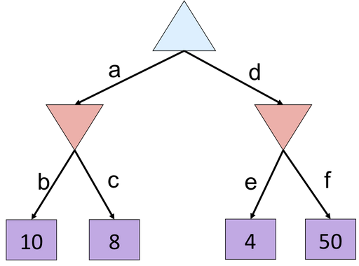
Quiz: Minimax Example
What is the value of the blue triangle?
A) 10
B) 8
C) 4
D) 50
Notes:
f is not evaluated

Slide 2
Quiz: Minimax Example
What is the value of the blue triangle?
A) 10
B) 8
C) 4
D) 50
8
8
4
Notes:
f is not evaluated

Slide 3
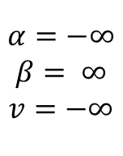
Alpha-Beta Small Example
def max-value(state, α, β):
  initialize v = -∞
  for each successor of state:
    v = max(v, value(successor, α, β))
    if v ≥ β
    return v
    α = max(α, v)
  return v
$$α=−∞$$
$$β= ∞$$
$$v=−∞$$
def min-value(state , α, β):
  initialize v = +∞
  for each successor of state:
    v = min(v, value(successor, α, β))
    if v ≤ α
    return v
    β = min(β, v)
  return v
Notes:
f is not evaluated

Slide 4
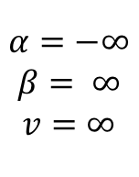
Alpha-Beta Small Example
def max-value(state, α, β):
  initialize v = -∞
  for each successor of state:
    v = max(v, value(successor, α, β))
    if v ≥ β
    return v
    α = max(α, v)
  return v
$$α=−∞$$
$$β= ∞$$
$$v=−∞$$
$$α=−∞$$
$$β= ∞$$
$$v=∞$$
def min-value(state , α, β):
  initialize v = +∞
  for each successor of state:
    v = min(v, value(successor, α, β))
    if v ≤ α
    return v
    β = min(β, v)
  return v
Notes:
f is not evaluated

Slide 5
Alpha-Beta Small Example
def max-value(state, α, β):
  initialize v = -∞
  for each successor of state:
    v = max(v, value(successor, α, β))
    if v ≥ β
    return v
    α = max(α, v)
  return v
$$α=−∞$$
$$β= ∞$$
$$v=−∞$$
$$α=−∞$$
$$β= ∞$$
$$v=∞$$
def min-value(state , α, β):
  initialize v = +∞
  for each successor of state:
    v = min(v, value(successor, α, β))
    if v ≤ α
    return v
    β = min(β, v)
  return v
Notes:
f is not evaluated

Slide 6
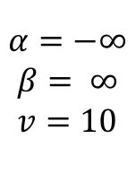
Alpha-Beta Small Example
def max-value(state, α, β):
  initialize v = -∞
  for each successor of state:
    v = max(v, value(successor, α, β))
    if v ≥ β
    return v
    α = max(α, v)
  return v
$$α=−∞$$
$$β= ∞$$
$$v=−∞$$
$$α=−∞$$
$$β= ∞$$
$$v=10$$
def min-value(state , α, β):
  initialize v = +∞
  for each successor of state:
    v = min(v, value(successor, α, β))
    if v ≤ α
    return v
    β = min(β, v)
  return v
Notes:
f is not evaluated

Slide 7
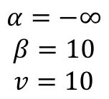
Alpha-Beta Small Example
def max-value(state, α, β):
  initialize v = -∞
  for each successor of state:
    v = max(v, value(successor, α, β))
    if v ≥ β
    return v
    α = max(α, v)
  return v
$$α=−∞$$
$$β= ∞$$
$$v=−∞$$
$$α=−∞$$
$$β=10$$
$$v=10$$
def min-value(state , α, β):
  initialize v = +∞
  for each successor of state:
    v = min(v, value(successor, α, β))
    if v ≤ α
    return v
    β = min(β, v)
  return v
Notes:
f is not evaluated

Slide 8
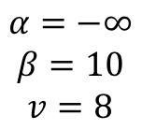
Alpha-Beta Small Example
def max-value(state, α, β):
  initialize v = -∞
  for each successor of state:
    v = max(v, value(successor, α, β))
    if v ≥ β
    return v
    α = max(α, v)
  return v
$$α=−∞$$
$$β= ∞$$
$$v=−∞$$
$$α=−∞$$
$$β=10$$
$$v=8$$
def min-value(state , α, β):
  initialize v = +∞
  for each successor of state:
    v = min(v, value(successor, α, β))
    if v ≤ α
    return v
    β = min(β, v)
  return v
Notes:
f is not evaluated

Slide 9
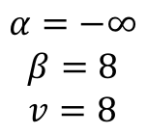
Alpha-Beta Small Example
def max-value(state, α, β):
  initialize v = -∞
  for each successor of state:
    v = max(v, value(successor, α, β))
    if v ≥ β
    return v
    α = max(α, v)
  return v
$$α=−∞$$
$$β= ∞$$
$$v=−∞$$
$$α=−∞$$
$$β=8$$
$$v=8$$
def min-value(state , α, β):
  initialize v = +∞
  for each successor of state:
    v = min(v, value(successor, α, β))
    if v ≤ α
    return v
    β = min(β, v)
  return v
Notes:
f is not evaluated

Slide 10
Alpha-Beta Small Example
def max-value(state, α, β):
  initialize v = -∞
  for each successor of state:
    v = max(v, value(successor, α, β))
    if v ≥ β
    return v
    α = max(α, v)
  return v
$$α=−∞$$
$$β= ∞$$
$$v=−∞$$
$$α=−∞$$
$$β=8$$
$$v=8$$
8
def min-value(state , α, β):
  initialize v = +∞
  for each successor of state:
    v = min(v, value(successor, α, β))
    if v ≤ α
    return v
    β = min(β, v)
  return v
Notes:
f is not evaluated

Slide 11
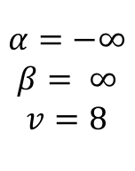
Alpha-Beta Small Example
def max-value(state, α, β):
  initialize v = -∞
  for each successor of state:
    v = max(v, value(successor, α, β))
    if v ≥ β
    return v
    α = max(α, v)
  return v
$$α=−∞$$
$$β= ∞$$
$$v=8$$
$$α=−∞$$
$$β=8$$
$$v=8$$
8
def min-value(state , α, β):
  initialize v = +∞
  for each successor of state:
    v = min(v, value(successor, α, β))
    if v ≤ α
    return v
    β = min(β, v)
  return v
Notes:
f is not evaluated

Slide 12
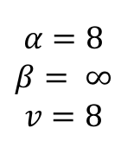
Alpha-Beta Small Example
def max-value(state, α, β):
  initialize v = -∞
  for each successor of state:
    v = max(v, value(successor, α, β))
    if v ≥ β
    return v
    α = max(α, v)
  return v
$$α=8$$
$$β= ∞$$
$$v=8$$
$$α=−∞$$
$$β=8$$
$$v=8$$
8
def min-value(state , α, β):
  initialize v = +∞
  for each successor of state:
    v = min(v, value(successor, α, β))
    if v ≤ α
    return v
    β = min(β, v)
  return v
Notes:
f is not evaluated

Slide 13
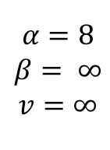
Alpha-Beta Small Example
def max-value(state, α, β):
  initialize v = -∞
  for each successor of state:
    v = max(v, value(successor, α, β))
    if v ≥ β
    return v
    α = max(α, v)
  return v
$$α=8$$
$$β= ∞$$
$$v=8$$
$$α=−∞$$
$$β=8$$
$$v=8$$
$$α=8$$
$$β= ∞$$
$$v=∞$$
8
def min-value(state , α, β):
  initialize v = +∞
  for each successor of state:
    v = min(v, value(successor, α, β))
    if v ≤ α
    return v
    β = min(β, v)
  return v
Notes:
f is not evaluated

Slide 14
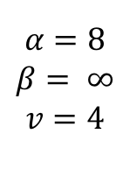
Alpha-Beta Small Example
def max-value(state, α, β):
  initialize v = -∞
  for each successor of state:
    v = max(v, value(successor, α, β))
    if v ≥ β
    return v
    α = max(α, v)
  return v
$$α=8$$
$$β= ∞$$
$$v=8$$
$$α=−∞$$
$$β=8$$
$$v=8$$
$$α=8$$
$$β= ∞$$
$$v=4$$
8
def min-value(state , α, β):
  initialize v = +∞
  for each successor of state:
    v = min(v, value(successor, α, β))
    if v ≤ α
    return v
    β = min(β, v)
  return v
Notes:
f is not evaluated

Slide 15
Alpha-Beta Small Example
def max-value(state, α, β):
  initialize v = -∞
  for each successor of state:
    v = max(v, value(successor, α, β))
    if v ≥ β
    return v
    α = max(α, v)
  return v
$$α=8$$
$$β= ∞$$
$$v=8$$
$$α=−∞$$
$$β=8$$
$$v=8$$
$$α=8$$
$$β= ∞$$
$$v=4$$
8
4
def min-value(state , α, β):
  initialize v = +∞
  for each successor of state:
    v = min(v, value(successor, α, β))
    if v ≤ α
    return v
    β = min(β, v)
  return v
Notes:
f is not evaluated

Slide 16
Alpha-Beta Small Example
def max-value(state, α, β):
  initialize v = -∞
  for each successor of state:
    v = max(v, value(successor, α, β))
    if v ≥ β
    return v
    α = max(α, v)
  return v
$$α=8$$
$$β= ∞$$
$$v=8$$
$$α=−∞$$
$$β=8$$
$$v=8$$
$$α=8$$
$$β= ∞$$
$$v=4$$
8
4
def min-value(state , α, β):
  initialize v = +∞
  for each successor of state:
    v = min(v, value(successor, α, β))
    if v ≤ α
    return v
    β = min(β, v)
  return v
Notes:
f is not evaluated

Slide 17
Alpha-Beta Small Example
def max-value(state, α, β):
  initialize v = -∞
  for each successor of state:
    v = max(v, value(successor, α, β))
    if v ≥ β
    return v
    α = max(α, v)
  return v
$$α=8$$
$$β= ∞$$
$$v=8$$
$$α=−∞$$
$$β=8$$
$$v=8$$
$$α=8$$
$$β= ∞$$
$$v=4$$
8
4
def min-value(state , α, β):
  initialize v = +∞
  for each successor of state:
    v = min(v, value(successor, α, β))
    if v ≤ α
    return v
    β = min(β, v)
  return v
Notes:
f is not evaluated

Slide 18
Alpha-Beta Small Example
def max-value(state, α, β):
  initialize v = -∞
  for each successor of state:
    v = max(v, value(successor, α, β))
    if v ≥ β
    return v
    α = max(α, v)
  return v
$$α=8$$
$$β= ∞$$
$$v=8$$
8
$$α=−∞$$
$$β=8$$
$$v=8$$
$$α=8$$
$$β= ∞$$
$$v=4$$
8
4
def min-value(state , α, β):
  initialize v = +∞
  for each successor of state:
    v = min(v, value(successor, α, β))
    if v ≤ α
    return v
    β = min(β, v)
  return v
Notes:
f is not evaluated

Slide 19
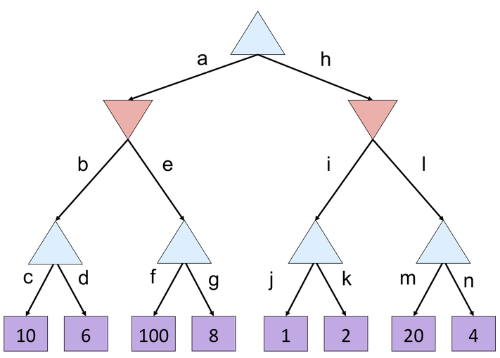
Minimax Quiz
What is the value of the top node?
A) 10
B) 100
C) 2
D) 4

Slide 20
Alpha Beta Quiz
Which branches are pruned?
A) e, l
B) g, l
C) g, k, l
D) g, n

Slide 21

Alpha-Beta Quiz 2
α =
10
?
β =
10
β =
2
?
?
1
2
v=
α=
10
α=
100
?
?
?

