Slide 1
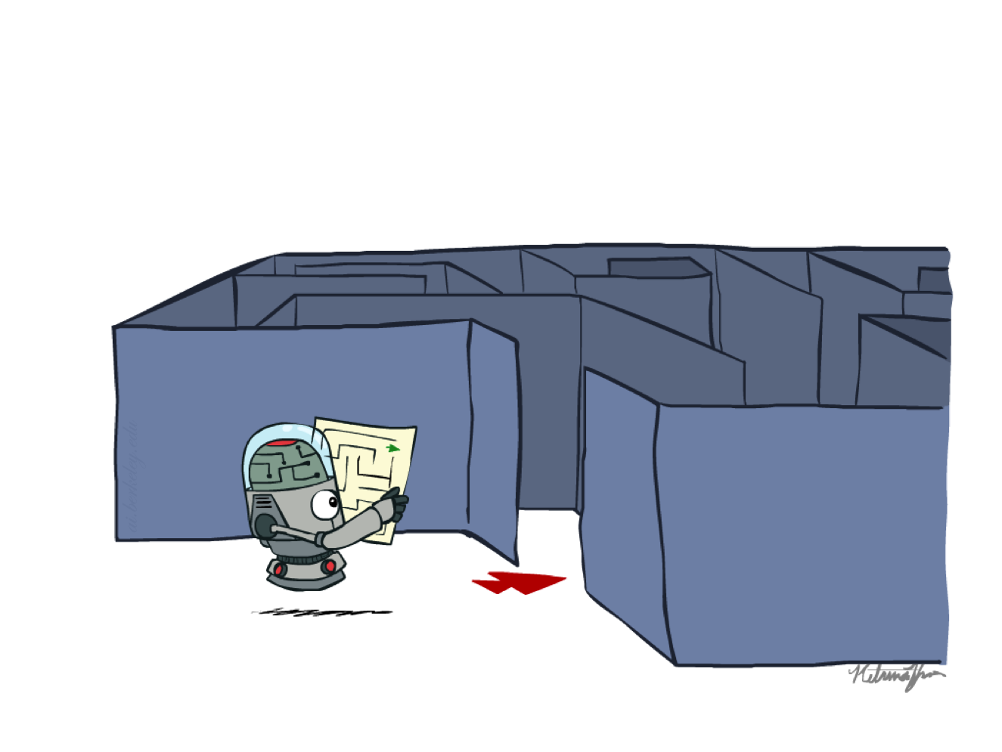
CS 188: Artificial Intelligence
Uniformed Search
Instructors: Eren Gultepe
SIUE
[These slides were adapted from Dan Klein and Pieter Abbeel for CS188 Intro to AI at UC Berkeley (ai.berkeley.edu).]
Notes:
Please retain proper attribution, including the reference to ai.berkeley.edu. Thanks!

Slide 2
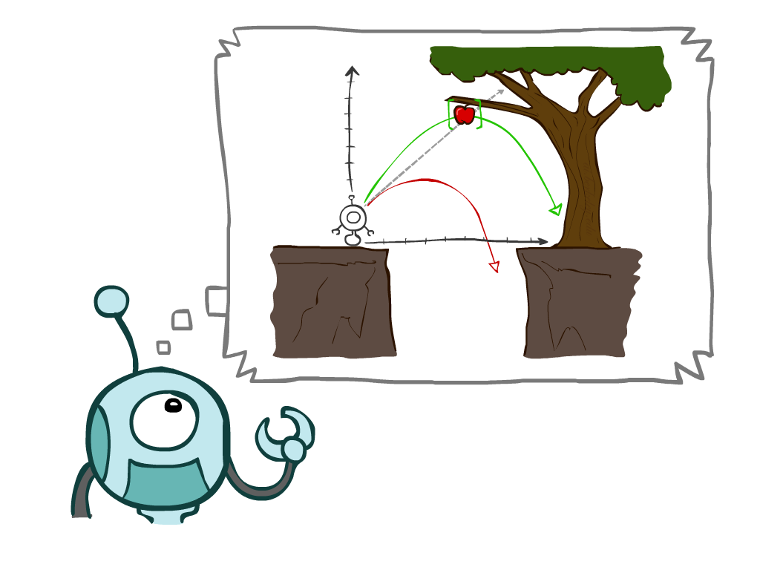
Today
Agents that Plan Ahead
Search Problems
Uninformed Search Methods
Depth-First Search
Breadth-First Search
Uniform-Cost Search
Notes:
General theme in the class:
A goal we have in mind.
A mathematical abstraction to formalize this
Algorithms that operate on these abstractions

Slide 3
Agents that Plan

Slide 4
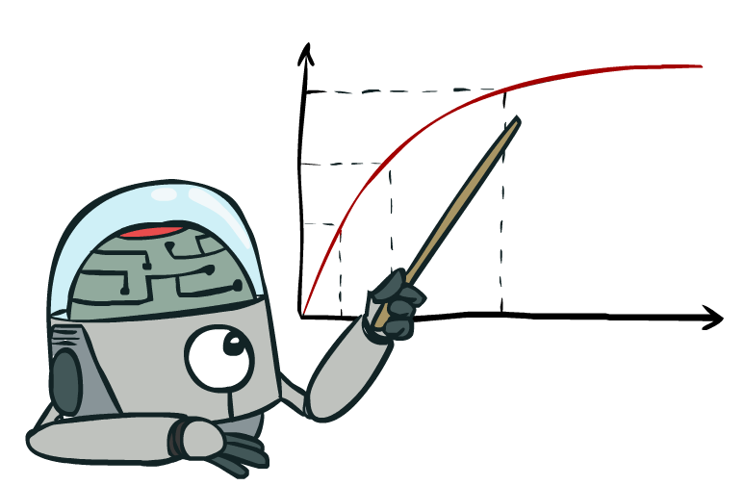
Rationality, contd.
What is rational depends on:
Performance measure
Agent’s prior knowledge of environment
Actions available to agent
Percept sequence to date
Being rational means maximizing your expected utility

Slide 5
Rational Agents
Are rational agents omniscient?
No – they are limited by the available percepts
Are rational agents clairvoyant?
No – they may lack knowledge of the environment dynamics
Do rational agents explore and learn?
Yes – in unknown environments these are essential
So rational agents are not necessarily successful, but they are autonomous (i.e., transcend initial program)

Slide 6
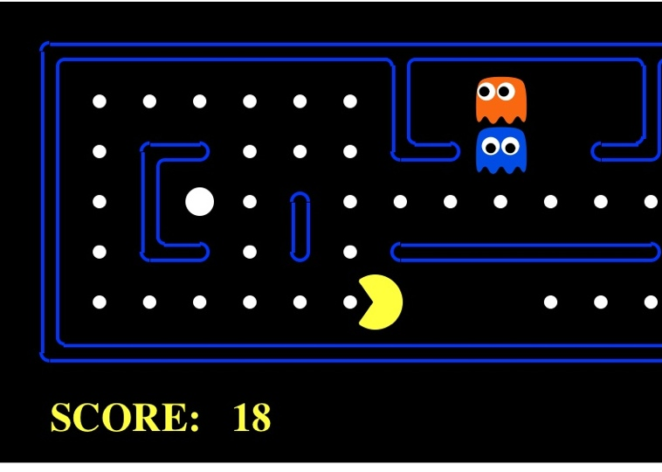
Task Environment - PEAS
Performance measure
-1 per step; +10 food; +500 win; -500 die; +200 hit scared ghost
Environment
Pacman dynamics (incl ghost behavior)
Actuators
North, South, East, West, (Stop)
Sensors
Entire state is visible

Slide 7

PEAS: Automated Taxi
Performance measure
Income, happy customer, vehicle costs, fines, insurance premiums
Environment
US streets, other drivers, customers
Actuators
Steering, brake, gas, display/speaker
Sensors
Camera, radar, accelerometer, engine sensors, microphone
Image: http://nypost.com/2014/06/21/how-google-might-put-taxi-drivers-out-of-business/

Slide 8

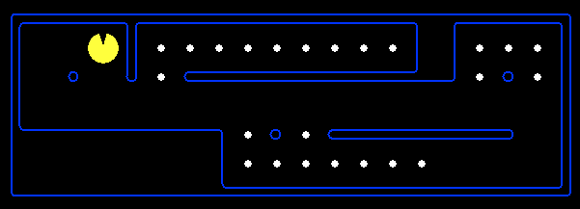
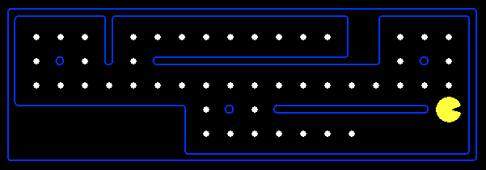
Reflex Agents
Reflex agents:
Choose action based on current percept (and maybe memory)
May have memory or a model of the world’s current state
Do not consider the future consequences of their actions
Consider how the world IS
Can a reflex agent be rational?
[Demo: reflex optimal (L2D1)]
[Demo: reflex optimal (L2D2)]
Notes:
Examples: blinking your eye (not using your entire thinking capabilities), vacuum cleaner moving towards nearest dirt

Slide 9
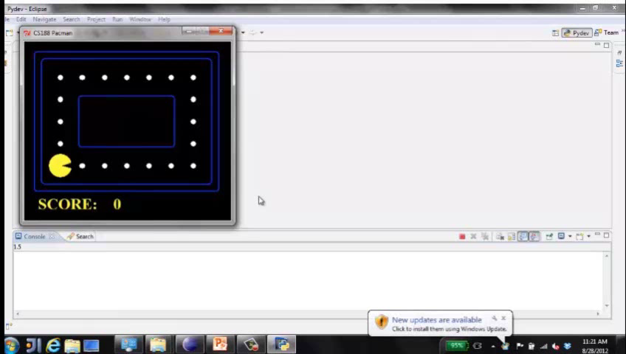
Video of Demo Reflex Optimal

Slide 10
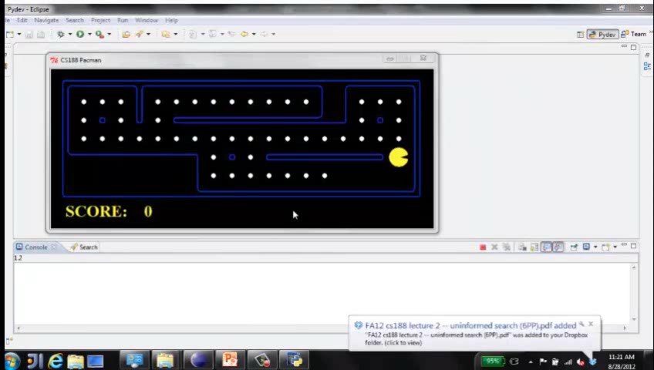
Video of Demo Reflex Odd

Slide 11

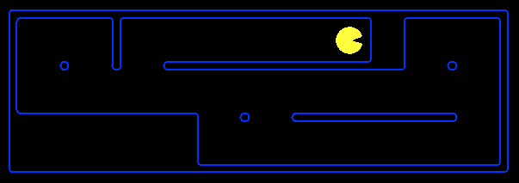
Planning Agents
Planning agents:
Ask “what if”
Decisions based on (hypothesized) consequences of actions
Must have a model of how the world evolves in response to actions
Must formulate a goal (test)
Consider how the world WOULD BE
Optimal vs. complete planning
Planning vs. replanning
[Demo: re-planning (L2D3)]
[Demo: mastermind (L2D4)]

Slide 12
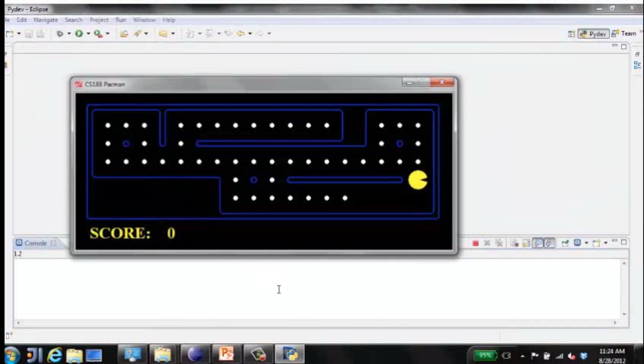
Video of Demo Replanning

Slide 13
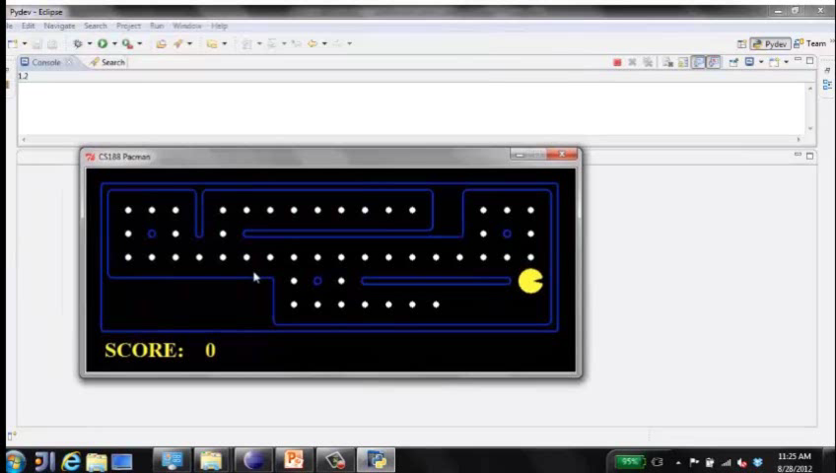
Video of Demo Mastermind

Slide 14

Search Problems

Slide 15







Search Problems
A search problem consists of:
A state space
A successor function
(with actions, costs)
A start state and a goal test
A solution is a sequence of actions (a plan) which transforms the start state to a goal state
“N”, 1.0
“E”, 1.0
Notes:
Often comes back on exams
Goal test – sometimes more than one state that satisfies having achieved the goal, for example, “eat all the dots”
Abstraction

Slide 16

Search Problems Are Models

Slide 17
Example: Traveling in Romania
State space:
Cities
Successor function:
Roads: Go to adjacent city with cost = distance
Start state:
Arad
Goal test:
Is state == Bucharest?
Solution?

Slide 18
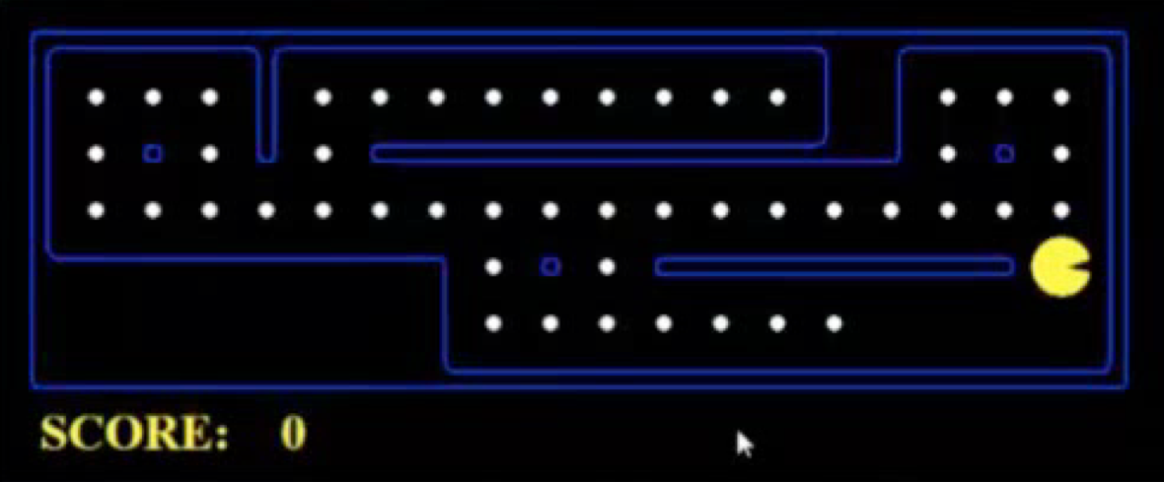
What’s in a State Space?
The world state includes every last detail of the environment
A search state keeps only the details needed for planning (abstraction)
Problem: Pathing
States: (x,y) location
Actions: NSEW
Successor: update location only
Goal test: is (x,y)=END
Problem: Eat-All-Dots
States: {(x,y), dot booleans}
Actions: NSEW
Successor: update location and possibly a dot boolean
Goal test: dots all false
Notes:
Wrong example for “eat-all-dots”: (x, y, dot count)

Slide 19
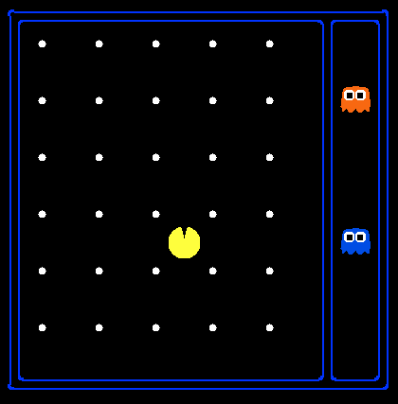
State Space Sizes?
World state:
Agent positions: 120
Food count: 30
Ghost positions: 12
Agent facing: NSEW
How many
World states?
120x(2³⁰)x(12²)x4
States for pathing?
120
States for eat-all-dots?
120x(2³⁰)
Notes:
90 * (2^30-1) + 30 * 2^29 = 145 billion
2^29 = 536 870 912

Slide 20
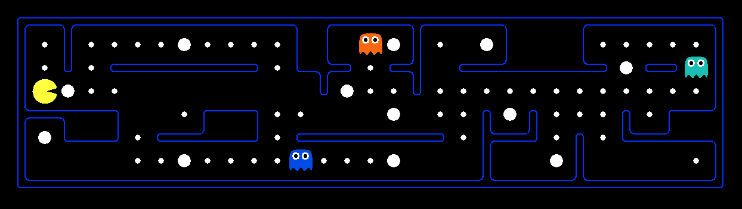
Quiz: Safe Passage
Problem: eat all dots while keeping the ghosts perma-scared
What does the state space have to specify?
(agent position, dot booleans, power pellet booleans, remaining scared time)

Slide 21

State Space Graphs and Search Trees

Slide 22
State Space Graphs
State space graph: A mathematical representation of a search problem
Nodes are (abstracted) world configurations
Arcs represent successors (action results)
The goal test is a set of goal nodes (maybe only one)
In a state space graph, each state occurs only once!
We can rarely build this full graph in memory (it’s too big), but it’s a useful idea

Slide 23
State Space Graphs
State space graph: A mathematical representation of a search problem
Nodes are (abstracted) world configurations
Arcs represent successors (action results)
The goal test is a set of goal nodes (maybe only one)
In a state space graph, each state occurs only once!
We can rarely build this full graph in memory (it’s too big), but it’s a useful idea
a
G
b
c
e
d
f
S
h
p
q
r
Tiny state space graph for a tiny search problem

Slide 24
Search Trees
This is now / start
“N”, 1.0
“E”, 1.0
Possible futures
A search tree:
A “what if” tree of plans and their outcomes
The start state is the root node
Children correspond to successors
Nodes show states, but correspond to PLANS that achieve those states
For most problems, we can never actually build the whole tree
Notes:
Different plans that achieve the same state, will be different nodes in the tree.

Slide 25
State Space Graphs vs. Search Trees
State Space Graph
Each NODE in in the search tree is an entire PATH in the state space graph.
Search Tree
S
a
G
d
e
p
b
c
q
b
c
e
h
r
d
e
f
a
a
h
r
p
q
f
S
h
We construct both on demand – and we construct as little as possible.
p
q
f
q
c
G
p
q
r
q
c
G
a
a

Slide 26

Quiz: State Space Graphs vs. Search Trees
Consider this 4-state graph:
How big is its search tree (from S)?
a
S
G
b
Important: Lots of repeated structure in the search tree!

Slide 27
Quiz: State Space Graphs vs. Search Trees
Consider this 4-state graph:
How big is its search tree (from S)?
a
S
G
b

Slide 28
Quiz: State Space Graphs vs. Search Trees
Consider this 4-state graph:
How big is its search tree (from S)?
a
s
a
b
S
G
b
G
a
G
b
a
G
b
G
…
…
Important: Lots of repeated structure in the search tree!

Slide 29
Tree Search

Slide 30
Search Example: Romania

Slide 31
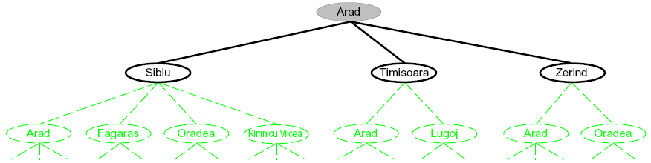
Searching with a Search Tree
Search:
Expand out potential plans (tree nodes)
Maintain a fringe of partial plans under consideration
Try to expand as few tree nodes as possible

Slide 32
General Tree Search
Important ideas:
Fringe
Expansion
Exploration strategy
Main question: which fringe nodes to explore?

Slide 33
Example: Tree Search
a
G
b
c
d
e
f
S
h
p
q
r
Notes:
Left: show tree
Right: fringe

Slide 34
Example: Tree Search
a
G
b
c
e
d
e
d
f
f
S
h
p
r
q
r
S
s
s → d
s → e
s → p
s → d → b
s → d → c
s → d → e
s → d → e → h
s → d → e → r
s → d → e → r → f
s → d → e → r → f → c
s → d → e → r → f → G
d
e
p
b
c
e
h
r
q
a
a
h
r
p
q
f
p
q
f
q
c
G
q
c
G
a
a

Slide 35
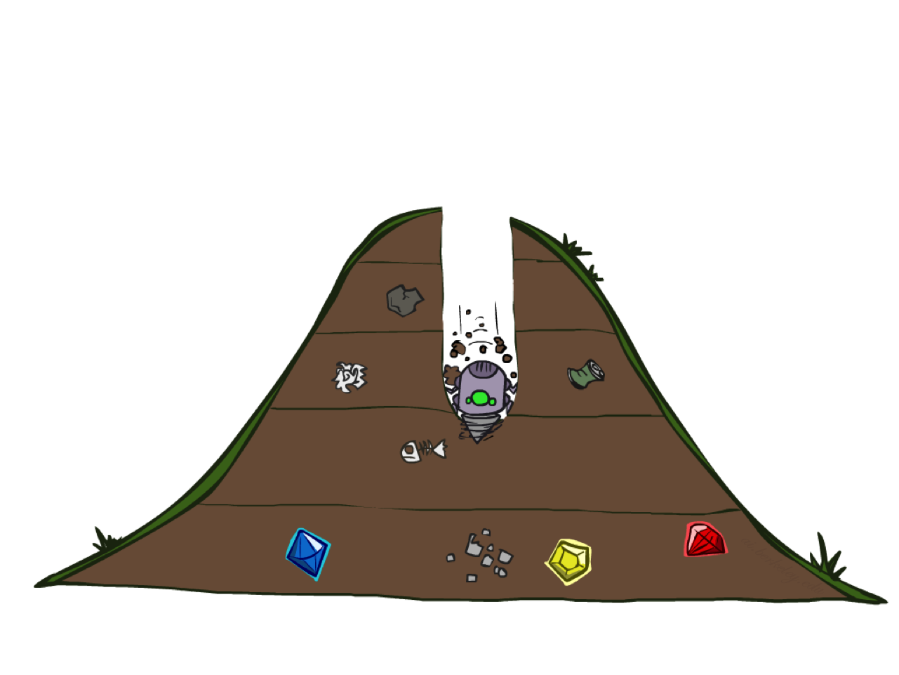
Depth-First Search

Slide 36
Depth-First Search
Strategy: expand a deepest node first
Implementation: Fringe is a LIFO stack
a
G
a
c
b
c
b
e
d
e
d
f
f
S
h
h
p
p
r
q
r
q
S
d
e
p
b
c
e
h
r
q
a
a
h
r
p
q
f
p
q
f
q
c
G
q
c
G
a
a

Slide 37
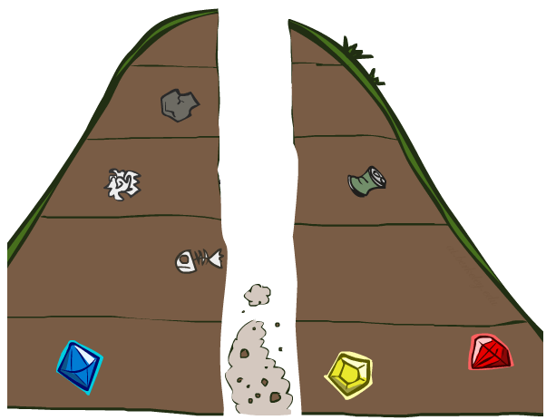
Search Algorithm Properties

Slide 38
Search Algorithm Properties
Complete: Guaranteed to find a solution if one exists?
Optimal: Guaranteed to find the least cost path?
Time complexity?
Space complexity?
Cartoon of search tree:
b is the branching factor
m is the maximum depth
solutions at various depths
Number of nodes in entire tree?
1 + b + b² + …. b^{m} = O(b^{m})
1 node
b
…
b nodes
b² nodes
m tiers
b^{m} nodes

Slide 39
Depth-First Search (DFS) Properties
What nodes DFS expand?
Some left prefix of the tree.
Could process the whole tree!
If m is finite, takes time O(b^{m})
How much space does the fringe take?
Only has siblings on path to root, so O(bm)
Is it complete?
m could be infinite, so only if we prevent cycles (more later)
Is it optimal?
No, it finds the “leftmost” solution, regardless of depth or cost
1 node
b
…
b nodes
b² nodes
m tiers
b^{m} nodes

Slide 40
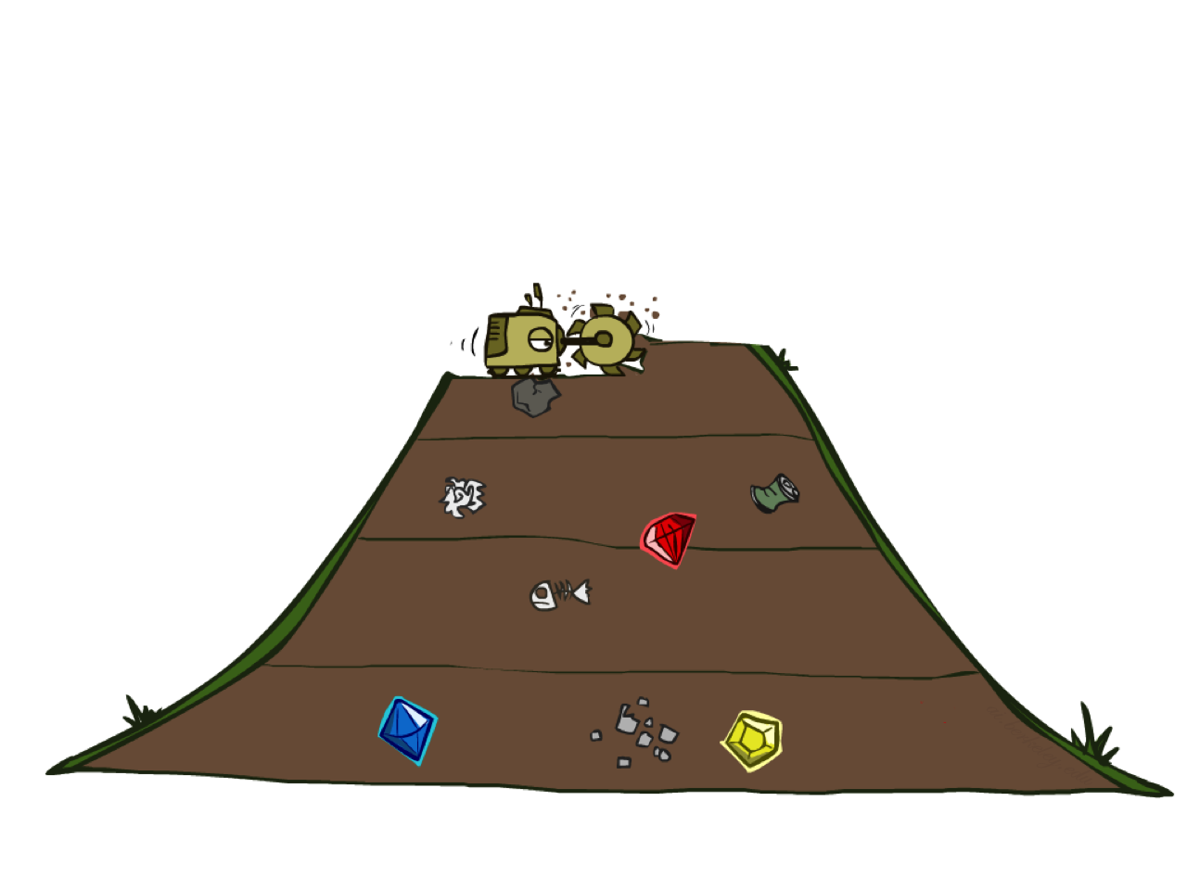
Breadth-First Search

Slide 41
Breadth-First Search
Strategy: expand a shallowest node first
Implementation: Fringe is a FIFO queue
a
G
b
c
d
e
f
S
h
p
q
r
S
d
e
p
Search
Tiers
b
c
e
h
r
q
a
a
h
r
p
q
f
p
q
f
q
c
G
q
c
G
a
a

Slide 42
Breadth-First Search (BFS) Properties
What nodes does BFS expand?
Processes all nodes above shallowest solution
Let depth of shallowest solution be s
Search takes time O(b^{s})
How much space does the fringe take?
Has roughly the last tier, so O(b^{s})
Is it complete?
s must be finite if a solution exists, so yes!
Is it optimal?
Only if costs are all 1 (more on costs later)
1 node
b
…
b nodes
s tiers
b² nodes
b^{s} nodes
b^{m} nodes

Slide 43
Quiz: DFS vs BFS

Slide 44
Quiz: DFS vs BFS
When will BFS outperform DFS?
When will DFS outperform BFS?
[Demo: dfs/bfs maze water (L2D6)]

Slide 45

Video of Demo Maze Water DFS/BFS (part 1)

Slide 46
Video of Demo Maze Water DFS/BFS (part 2)

Slide 47
Iterative Deepening
Idea: get DFS’s space advantage with BFS’s time / shallow-solution advantages
Run a DFS with depth limit 1. If no solution…
Run a DFS with depth limit 2. If no solution…
Run a DFS with depth limit 3. …..
Isn’t that wastefully redundant?
Generally most work happens in the lowest level searched, so not so bad!
b
…

Slide 48
Cost-Sensitive Search
a
GOAL
2
2
b
c
3
2
1
8
2
e
d
f
3
9
8
2
START
h
1
4
2
p
4
r
15
q
BFS finds the shortest path in terms of number of actions.
It does not find the least-cost path. We will now cover
a similar algorithm which does find the least-cost path.

Slide 49
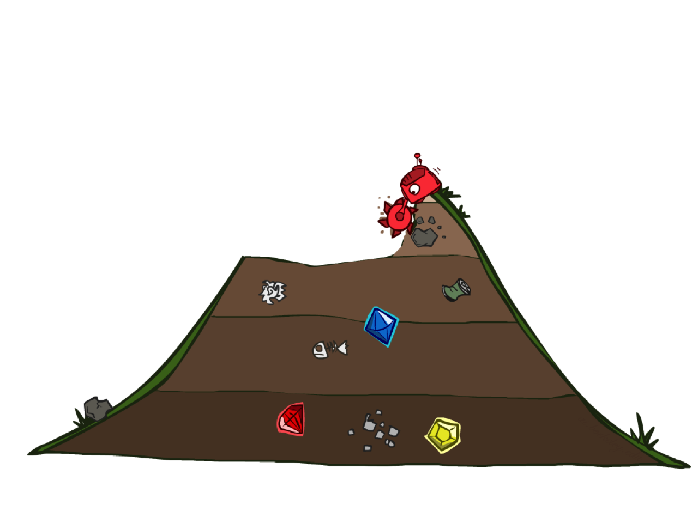
Uniform Cost Search

Slide 50
Uniform Cost Search
2
G
a
Strategy: expand a cheapest node first:
Fringe is a priority queue (priority: cumulative cost)
b
c
1
8
2
2
e
3
d
f
9
8
2
S
h
1
1
p
q
r
15
0
S
d
3
e
9
p
1
b
4
e
5
h
17
r
11
q
16
c
11
Cost contours
a
6
a
h
13
r
7
p
q
f
p
q
f
8
q
c
G
q
c
a
11
G
10
a

Slide 51
Uniform Cost Search (UCS) Properties
What nodes does UCS expand?
Processes all nodes with cost less than cheapest solution!
If that solution costs C* and arcs cost at least ε , then the “effective depth” is roughly C*/ε
Takes time O(b^{C*/ε}) (exponential in effective depth)
How much space does the fringe take?
Has roughly the last tier, so O(b^{C*/ε})
Is it complete?
Assuming best solution has a finite cost and minimum arc cost is positive, yes!
Is it optimal?
Yes! (Proof next lecture via A*)
b
c ≤ 1
…
C*/ε “tiers”
c ≤ 2
c ≤ 3

Slide 52
Uniform Cost Issues
Remember: UCS explores increasing cost contours
The good: UCS is complete and optimal!
The bad:
Explores options in every “direction”
No information about goal location
We’ll fix that soon!
…
c ≤ 1
c ≤ 2
c ≤ 3
Start
Goal
[Demo: empty grid UCS (L2D5)]
[Demo: maze with deep/shallow water DFS/BFS/UCS (L2D7)]

Slide 53
Video of Demo Empty UCS

Slide 54
Video of Demo Maze with Deep/Shallow Water --- DFS, BFS, or UCS? (part 1)
Notes:
Let students guess which one of the three it is. (This is BFS.)

Slide 55
Video of Demo Maze with Deep/Shallow Water --- DFS, BFS, or UCS? (part 2)
Notes:
Let students guess which one of the three it is. (This is UCS.)

Slide 56
Video of Demo Maze with Deep/Shallow Water --- DFS, BFS, or UCS? (part 3)
Notes:
Let students guess which one of the three it is. (This is DFS.)

Slide 57

The One Queue
All these search algorithms are the same except for fringe strategies
Conceptually, all fringes are priority queues (i.e. collections of nodes with attached priorities)
Practically, for DFS and BFS, you can avoid the log(n) overhead from an actual priority queue, by using stacks and queues
Can even code one implementation that takes a variable queuing object

Slide 58
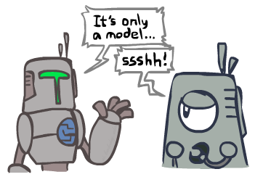
Search and Models
Search operates over models of the world
The agent doesn’t actually try all the plans out in the real world!
Planning is all “in simulation”
Your search is only as good as your models…

Slide 59
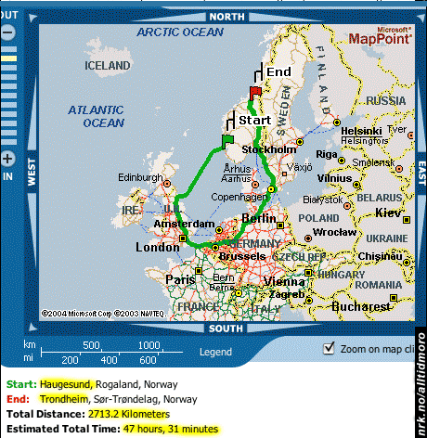
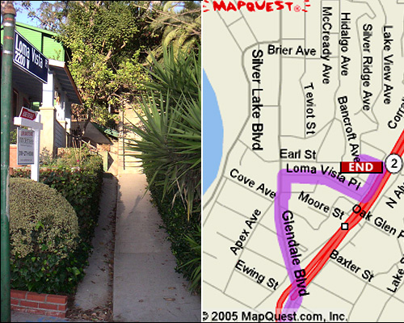

Search Gone Wrong?

Slide 60
Pseudocode Examples of Uniformed Search

Slide 61
function TREE_SEARCH(problem) returns a solution, or failure
initialize the frontier as a specific work list (stack, queue, priority queue)
add initial state of problem to frontier loop do
if the frontier is empty then
return failure choose a node and remove it from the frontier if the node contains a goal state then
return the corresponding solution
for each resulting child from node
add child to the frontier

Slide 62
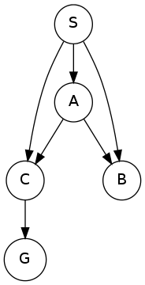
function GRAPH_SEARCH(problem) returns a solution, or failure
initialize the explored set to be empty
initialize the frontier as a specific work list (stack, queue, priority queue)
add initial state of problem to frontier loop do
if the frontier is empty then
return failure choose a node and remove it from the frontier if the node contains a goal state then
return the corresponding solution
add the node state to the explored set
for each resulting child from node
if the child state is not already in the frontier or explored set then
add child to the frontier

Slide 63
function UNIFORM-COST-SEARCH(problem) returns a solution, or failure
initialize the explored set to be empty
initialize the frontier as a priority queue using node path_cost as the priority
add initial state of problem to frontier with path_cost = 0 loop do
if the frontier is empty then
return failure choose a node and remove it from the frontier if the node contains a goal state then
return the corresponding solution
add the node state to the explored set
for each resulting child from node
if the child state is not already in the frontier or explored set then
add child to the frontier
else if the child is already in the frontier with higher path_cost then
replace that frontier node with child

